Slide 1
Introduction Reaction Network Modeling with BioNetGen
2021 Cell Modeling Workshop

Slide 2
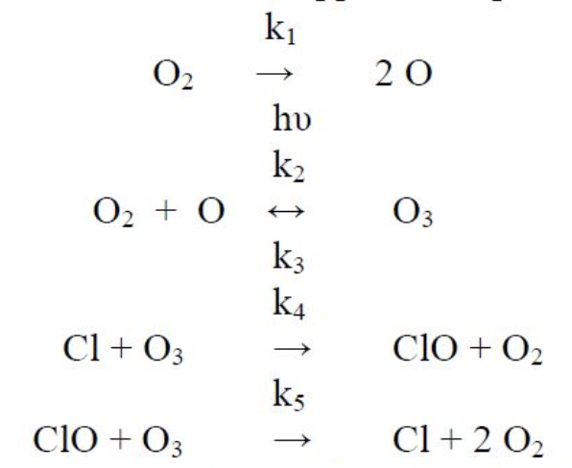
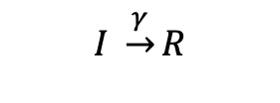
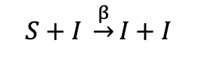
Reaction Networks Models can be used to describe a wide range of natural processes.
Chemistry
Epidemiology
Molecular biology
Ozone formation in the upper atmosphere
Susceptible-Infected-Recovered (SIR)
Signaling network
$$S+I \underset{→}{β}I+I$$
$$I \underset{→}{γ}R$$
Notes:
Credits:
Ozone formation reactions: https://www.chegg.com/homework-help/questions-and-answers/q-1-ozone-formation-upper-atmosphere-involves-following-reactions-ki-2-o-hu-k2-o2-o-k3-k4--q39635461
SIR model:
Signaling network: https://www.ebi.ac.uk/biomodels-main/static-pages.do?page=ModelMonth%2F2006-08

Slide 3
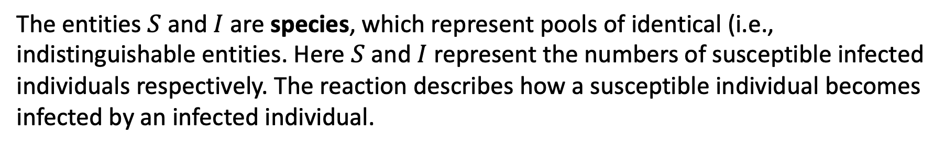
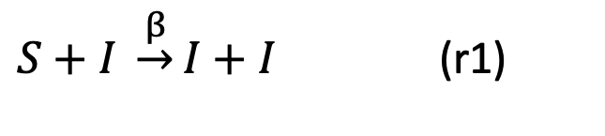
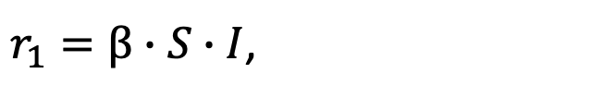
Reaction kinetics are defined by a few simple concepts.
Consider the reaction
$S+I \underset{→}{β}I+I$ (r1)
The entities $S$ and $I$ are species, which represent pools of identical (i.e., indistinguishable entities. Here $S$ and $I$ represent the numbers of susceptible infected individuals respectively. The reaction describes how a susceptible individual becomes infected by an infected individual.
The parameter $β$ is a rate constant, and the rate at which the reaction occurs is given by
$r_{1}=β∙S∙I$,
according the the simplest description given by mass action kinetics, which says that the rate of a reaction is given as the product of the reactant concentrations times the rate constant.

Slide 4
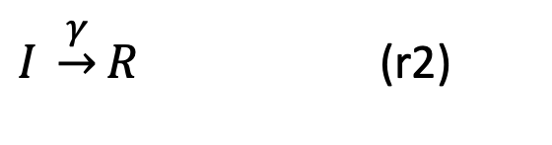
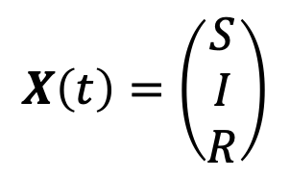
Reaction network models (RNM) are built from individual reactions.
The basic SIR model contains two reactions
$S+I \underset{→}{β}I+I$ (r1)
$I \underset{→}{γ}R$ (r2)
and three species: $S$, $I$, and $R$, which represents the number of recovered individuals.
An RNM tracks the values of the species concentrations as a function of time, which can be written as the vector
$$X\left(t\right)=\left(\begin{matrix}S \\ I \\ R\end{matrix}\right)$$
A complete RNM consists of a set of reactions, species, rate constants, and the initial values (also called initial concentrations) of the species, denoted $X\left(0\right).$

Slide 5
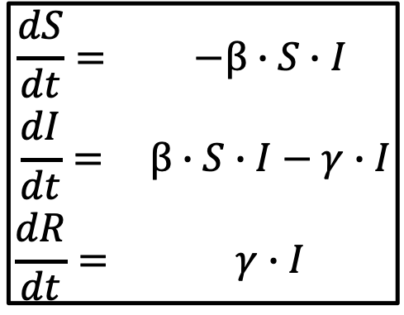
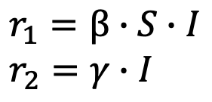
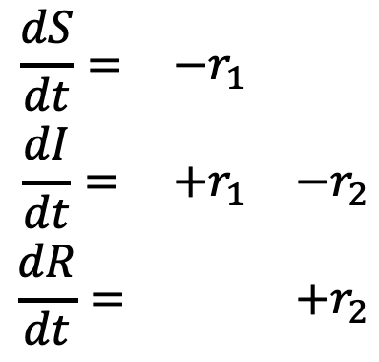
Ordinary differential equations (ODEs) describe the mean behavior of a reaction network.
The SIR model contains two reactions
$S+I \underset{→}{β}I+I$ (r1)
$I \underset{→}{γ}R$ (r2)
which give rise to three ODE’s
r1
r2
$$\begin{matrix}\frac{dS}{dt}= & −r_{1} & \\ \frac{dI}{dt}= & +r_{1} & −r_{2} \\ \frac{dR}{dt}= & & +r_{2}\end{matrix}$$
$$\begin{matrix}\frac{dS}{dt}= & −β∙S∙I \\ \frac{dI}{dt}= & β∙S∙I−γ∙I \\ \frac{dR}{dt}= & γ∙I\end{matrix}$$
where the rates are given by
$$r_{1}=β∙S∙I \\ r_{2}=γ∙I$$

Slide 6
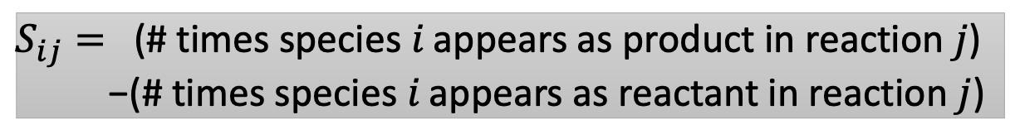
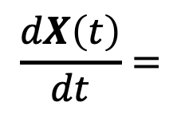
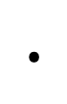
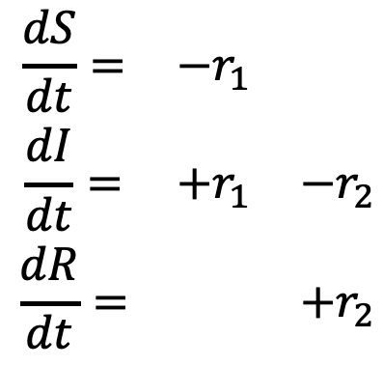
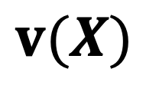
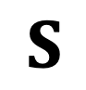
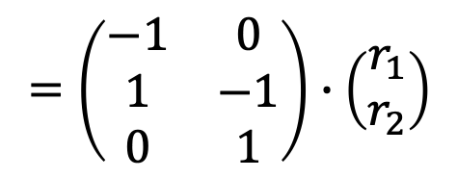
The ODEs for RNMs have a compact representation using the stoichiometry matrix.
r1
r2
$$\begin{matrix}\frac{dS}{dt}= & −r_{1} & \\ \frac{dI}{dt}= & +r_{1} & −r_{2} \\ \frac{dR}{dt}= & & +r_{2}\end{matrix}$$
$$\frac{dX\left(t\right)}{dt}=$$
$$=\left(\begin{matrix}−1 & 0 \\ 1 & −1 \\ 0 & 1\end{matrix}\right)∙\left(\begin{matrix}r_{1} \\ r_{2}\end{matrix}\right)$$
$$S$$
$$∙$$
$$v(X)$$
Stoichiometry matrix
Reaction fluxes
The elements of S are given by
$S_{ij}=$ (# times species 𝑖 appears as product in reaction $j$)
−(# times species 𝑖 appears as reactant in reaction $j$)

Slide 7
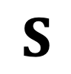
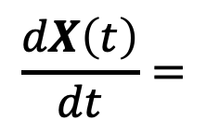
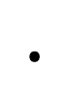
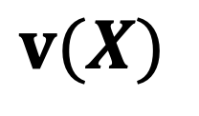
ODEs for most RNMs are solved numerically.
The general equation for RNM dynamics is
$$\frac{dX\left(t\right)}{dt}=$$
$$∙$$
$$S$$
$$v(X)$$
These equations are in general nonlinear.
They cannot be solved analytically except in special cases.
Numerical integration is required to obtain a solution.
“Stiffness” arises because reactions occur on different timescales, requiring special techniques to obtain accurate solutions efficiently.
Widely used solvers are CVODE and LSODA packages.
Accessed using ode method in the simulate command of BNG.

Slide 8
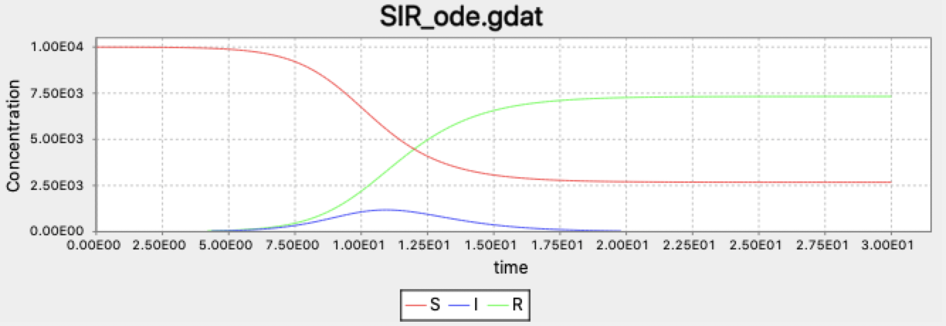
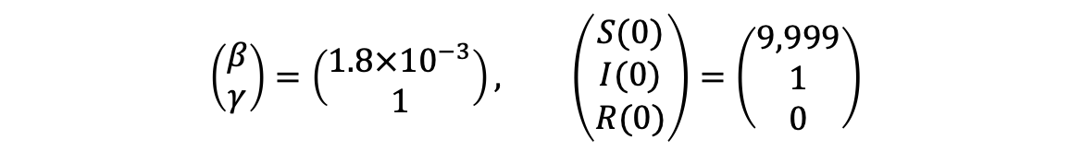
Numerical solution of SIR model describes dynamics of infection outbreak.
Time course for S, I, and R produced by BioNetGen and displayed in RuleBender.
$$\left(\begin{matrix}β \\ γ\end{matrix}\right)=\left(\begin{matrix}1.8×{10}^{−3} \\ 1\end{matrix}\right), \left(\begin{matrix}S(0) \\ I(0) \\ R(0)\end{matrix}\right)=\left(\begin{matrix}9,999 \\ 1 \\ 0\end{matrix}\right)$$

Slide 9
ODEs ignore the discrete nature of individuals in a network and neglect the effects of noise.
ODEs treat all variables as continuous and cannot account for the discrete nature of individuals.
ODEs in general (with exceptions) describe the average behavior of a system, but noise can affect real-world dynamics, e.g., disease outbreaks.
The same reaction network description can be used to generate stochastic time courses (“trajectories”) that exactly sample the true probability distribution.

Slide 10
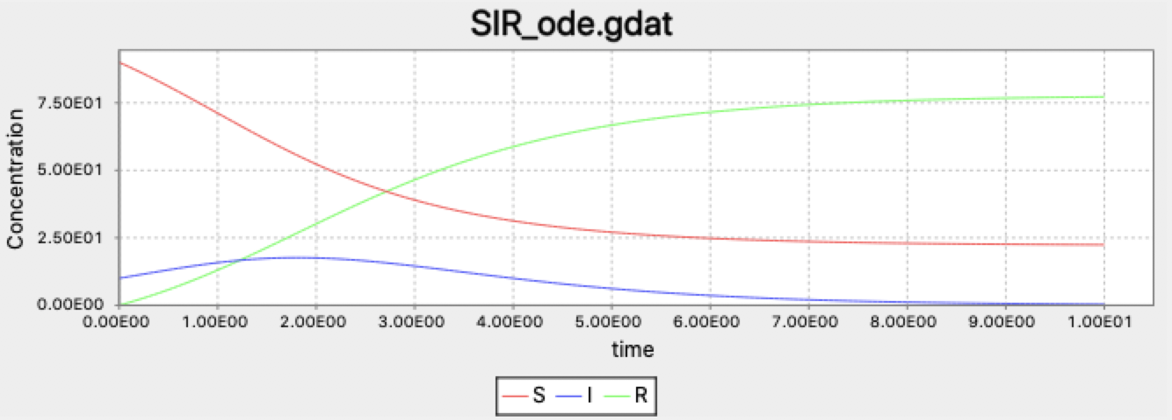
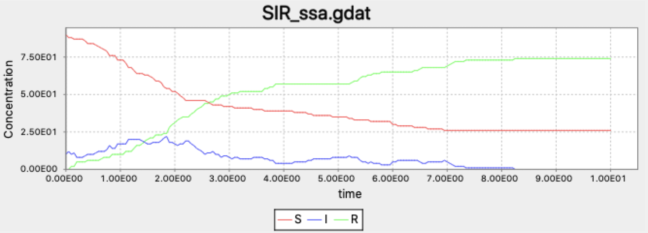
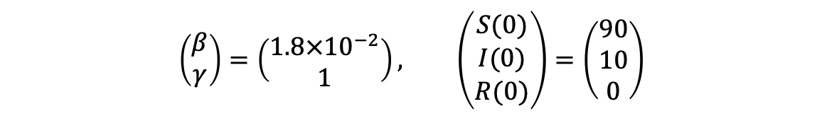
Stochastic simulations can reveal the effects of noise in finite populations.
ODE simulation
Stochastic simulation
SIR model with
$$\left(\begin{matrix}β \\ γ\end{matrix}\right)=\left(\begin{matrix}1.8×{10}^{−2} \\ 1\end{matrix}\right), \left(\begin{matrix}S(0) \\ I(0) \\ R(0)\end{matrix}\right)=\left(\begin{matrix}90 \\ 10 \\ 0\end{matrix}\right)$$

Slide 11
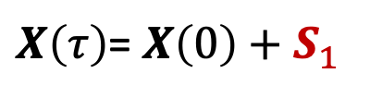
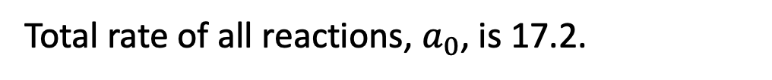
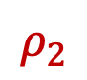
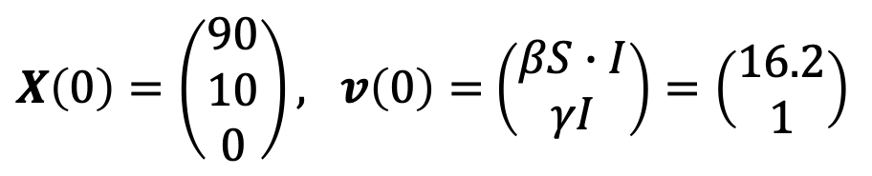
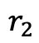
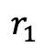
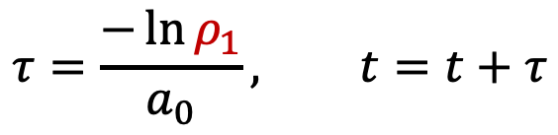
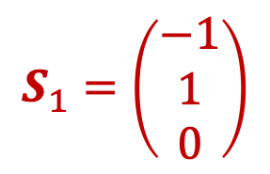
Stochastic dynamics can be computed with the Gillespie Algorithm.
BioNetGen’s ssa method
Gillespie’s Direct Method illustrated for the SIR model. At time t=0 we have
$X\left(0\right)=\left(\begin{matrix}90 \\ 10 \\ 0\end{matrix}\right), v\left(0\right)=$ $\left(\begin{matrix}βS∙I \\ γI\end{matrix}\right)=\left(\begin{matrix}16.2 \\ 1\end{matrix}\right)$
Total rate of all reactions, $a_{0}$, is 17.2.
$$τ=\frac{−\ln{ρ_{1}}}{a_{0}}, t=t+τ$$
Time of next reaction is chosen as
Index of next reaction, j, is chosen using so probability of each reaction firing is proportional to its rate.
$$r_{1}$$
$$r_{2}$$
$$S_{1}=\left(\begin{matrix}−1 \\ 1 \\ 0\end{matrix}\right)$$
$X\left(τ\right)$= $X\left(0\right)+S_{1}$
$$ρ_{2}$$

Slide 12
BioNetGen enables the construction, simulation and analysis of RNMs.
bionetgen
Command line interface
>bionetgen run –i model.bngl

Slide 13
RuleBender provides an interactive development environment for BioNetGen Models

Slide 14
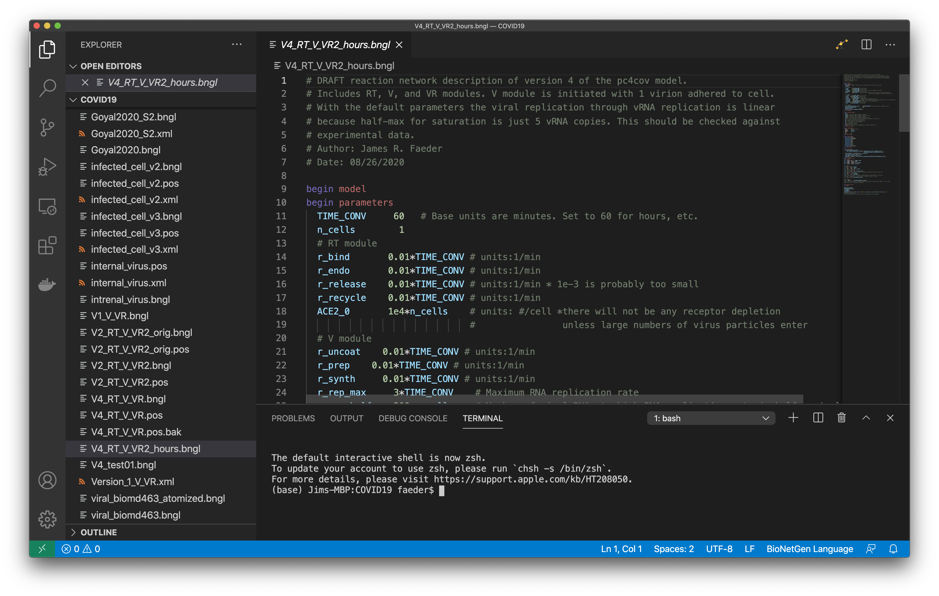
BioNetGen Extension for VS Code Provides Powerful Integrated Environment for Multiscale Modeling
Action button
Ali Sinan Saglam

Slide 15
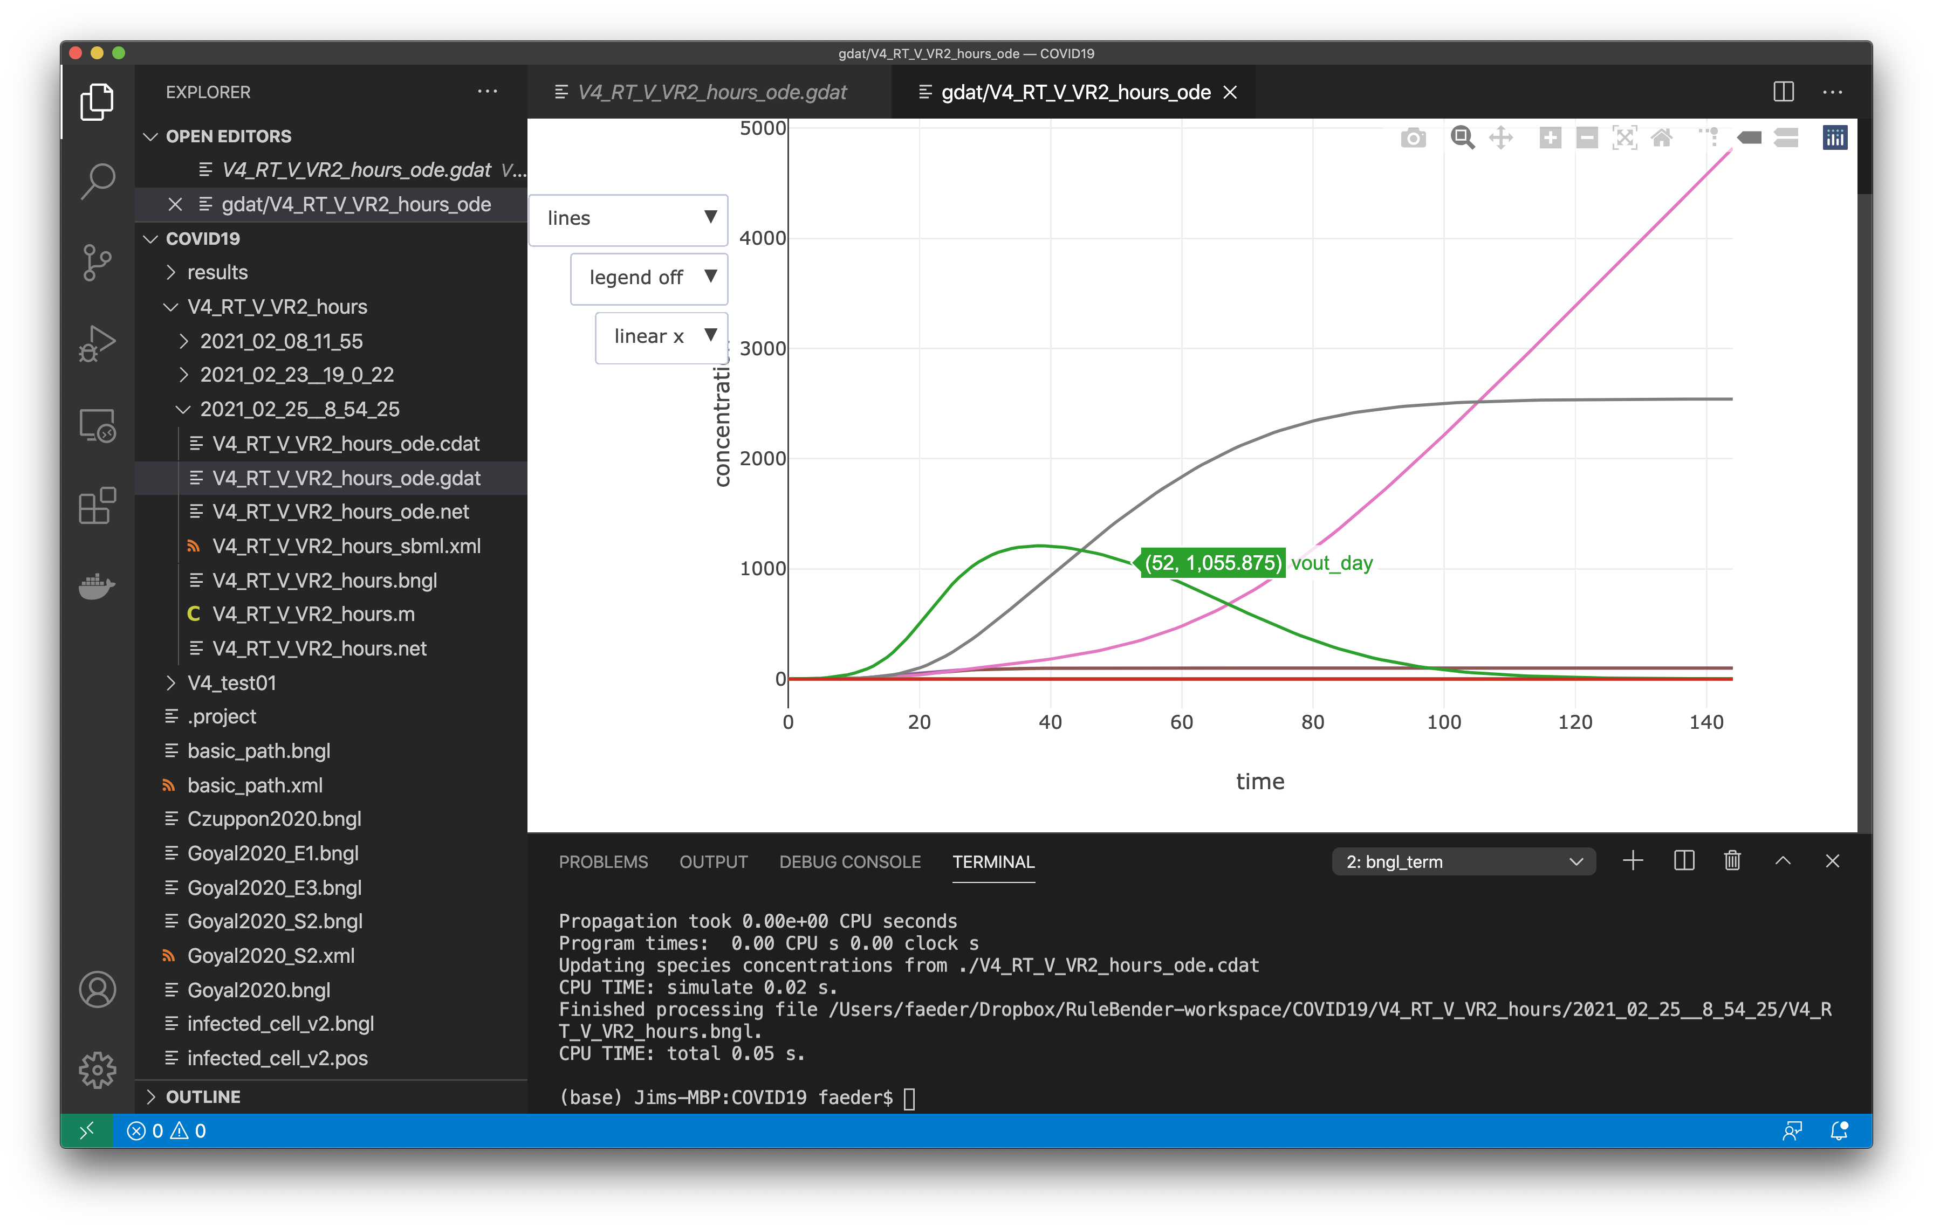
BioNetGen Extension for VS Code Provides Powerful Integrated Environment for Multiscale Modeling
Ali Sinan Saglam

Slide 16
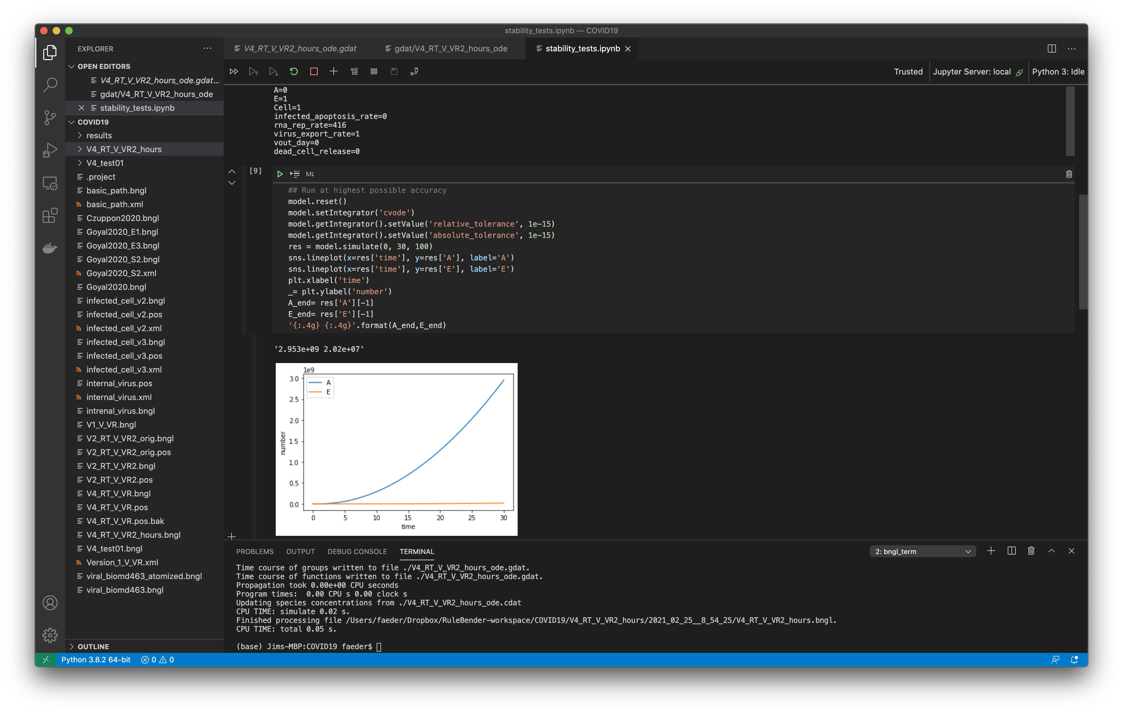
BioNetGen Extension for VS Code Provides Powerful Integrated Environment for Multiscale Modeling
Ali Sinan Saglam

Slide 17
Hands On Intro to BioNetGen with VS Code Extension
Reaction Network Models

Slide 18
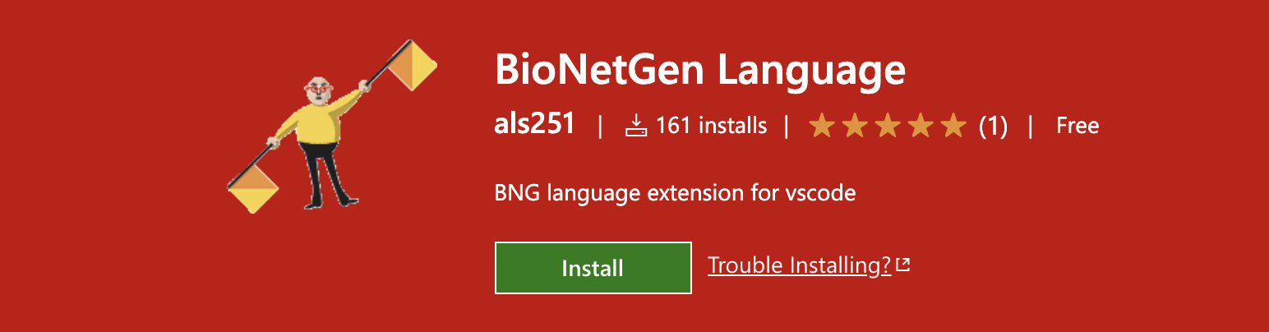
Setting up to use BioNetGen with the VS Code Extension
Download and install VS Code.
Install the BioNetGen Language Extension from the VS Code Marketplace.
(Windows only) Download and install Perl
Download and install Python3, preferably Anaconda Python.
Install BioNetGen on the command line using pip install bionetgen.

Slide 19
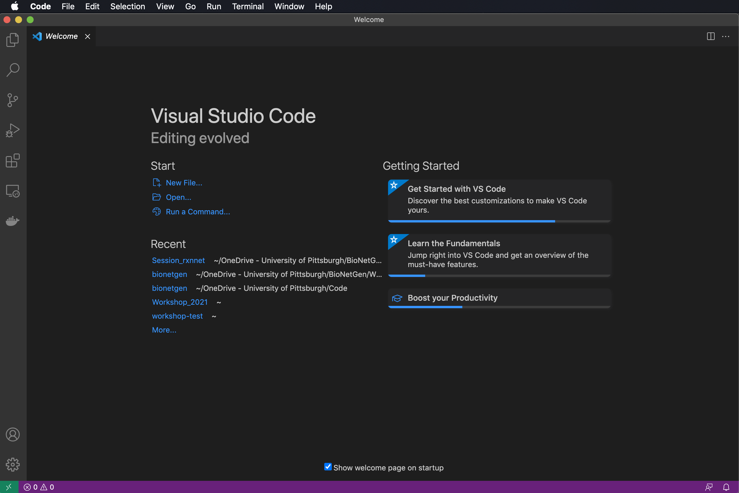
Launching VS Code for the first time
Click on Extensions to make sure BioNetGen is installed.

Slide 20
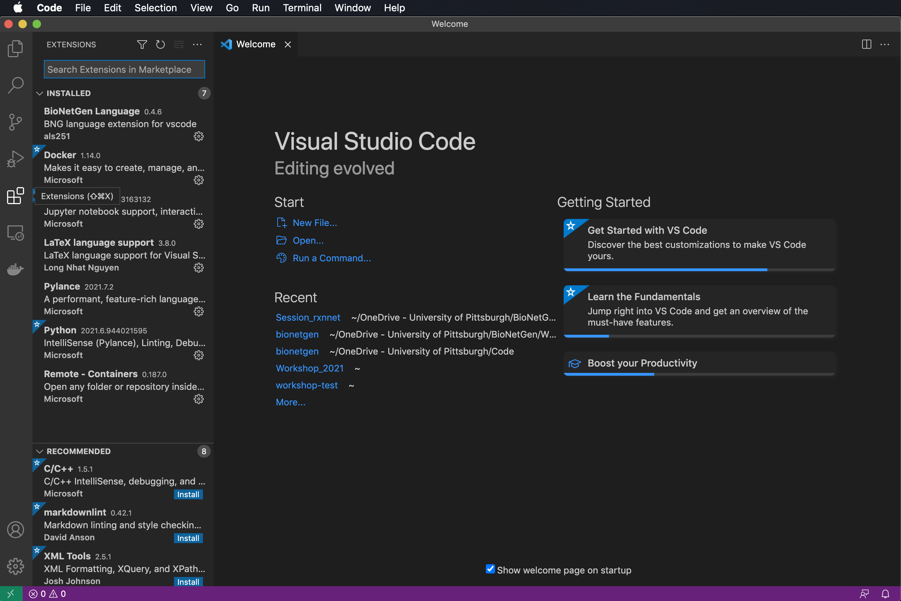
Launching VS Code for the first time
Click on Extensions to make sure BioNetGen is installed.

Slide 21
Launching VS Code for the first time
Click on Extensions to make sure BioNetGen is installed.
Click on Explorer to Open a folder or create new one (or click Open in the Welcome page).

Slide 22
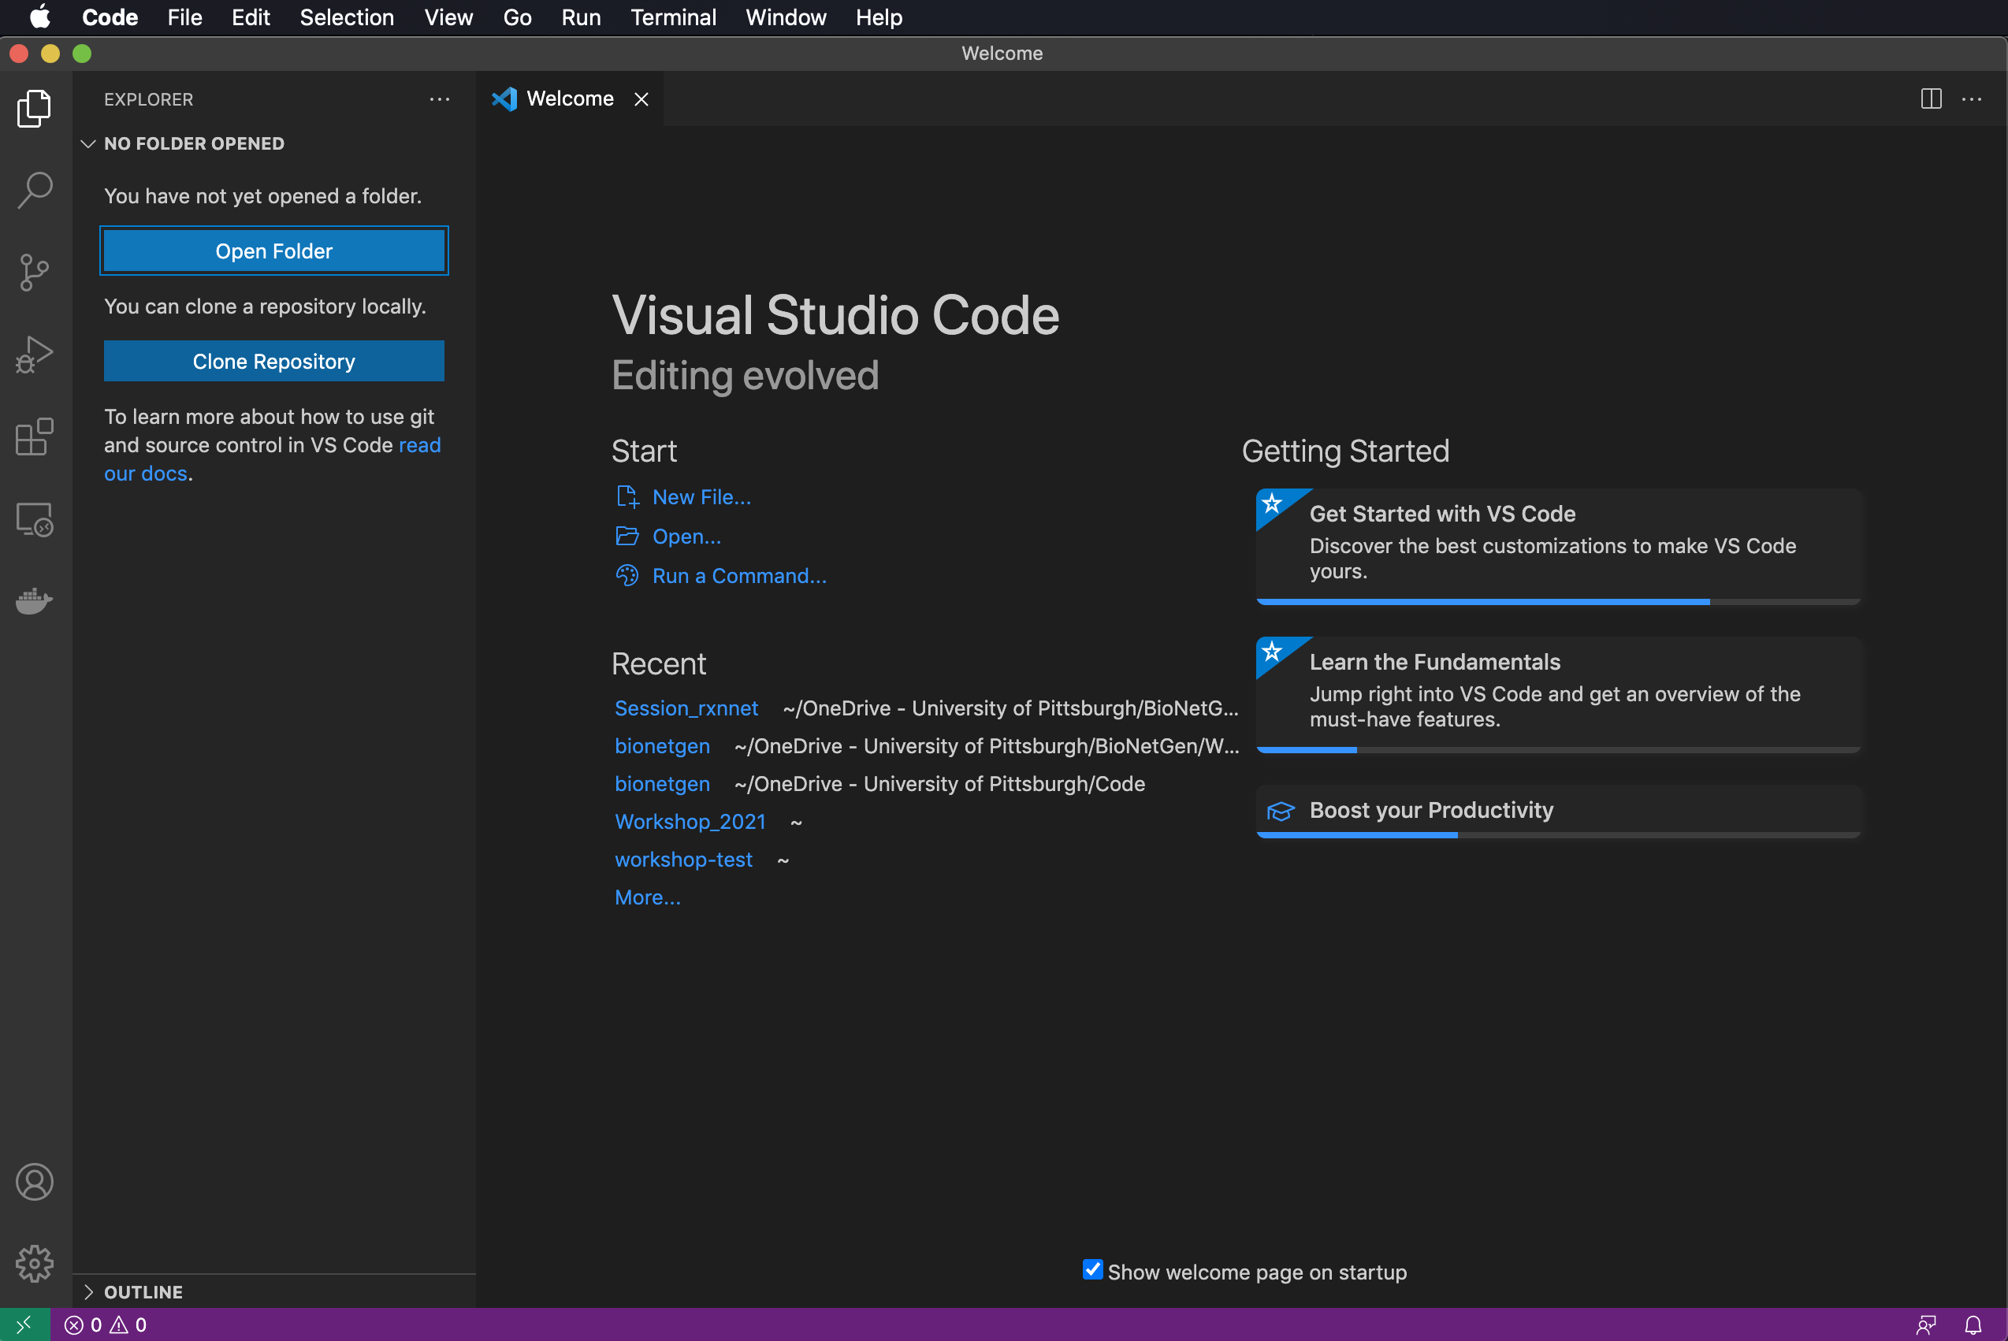
Launching VS Code for the first time
Click on Extensions to make sure BioNetGen is installed.
Click on Explorer to Open a folder or create new one (or click Open in the Welcome page).

Slide 23
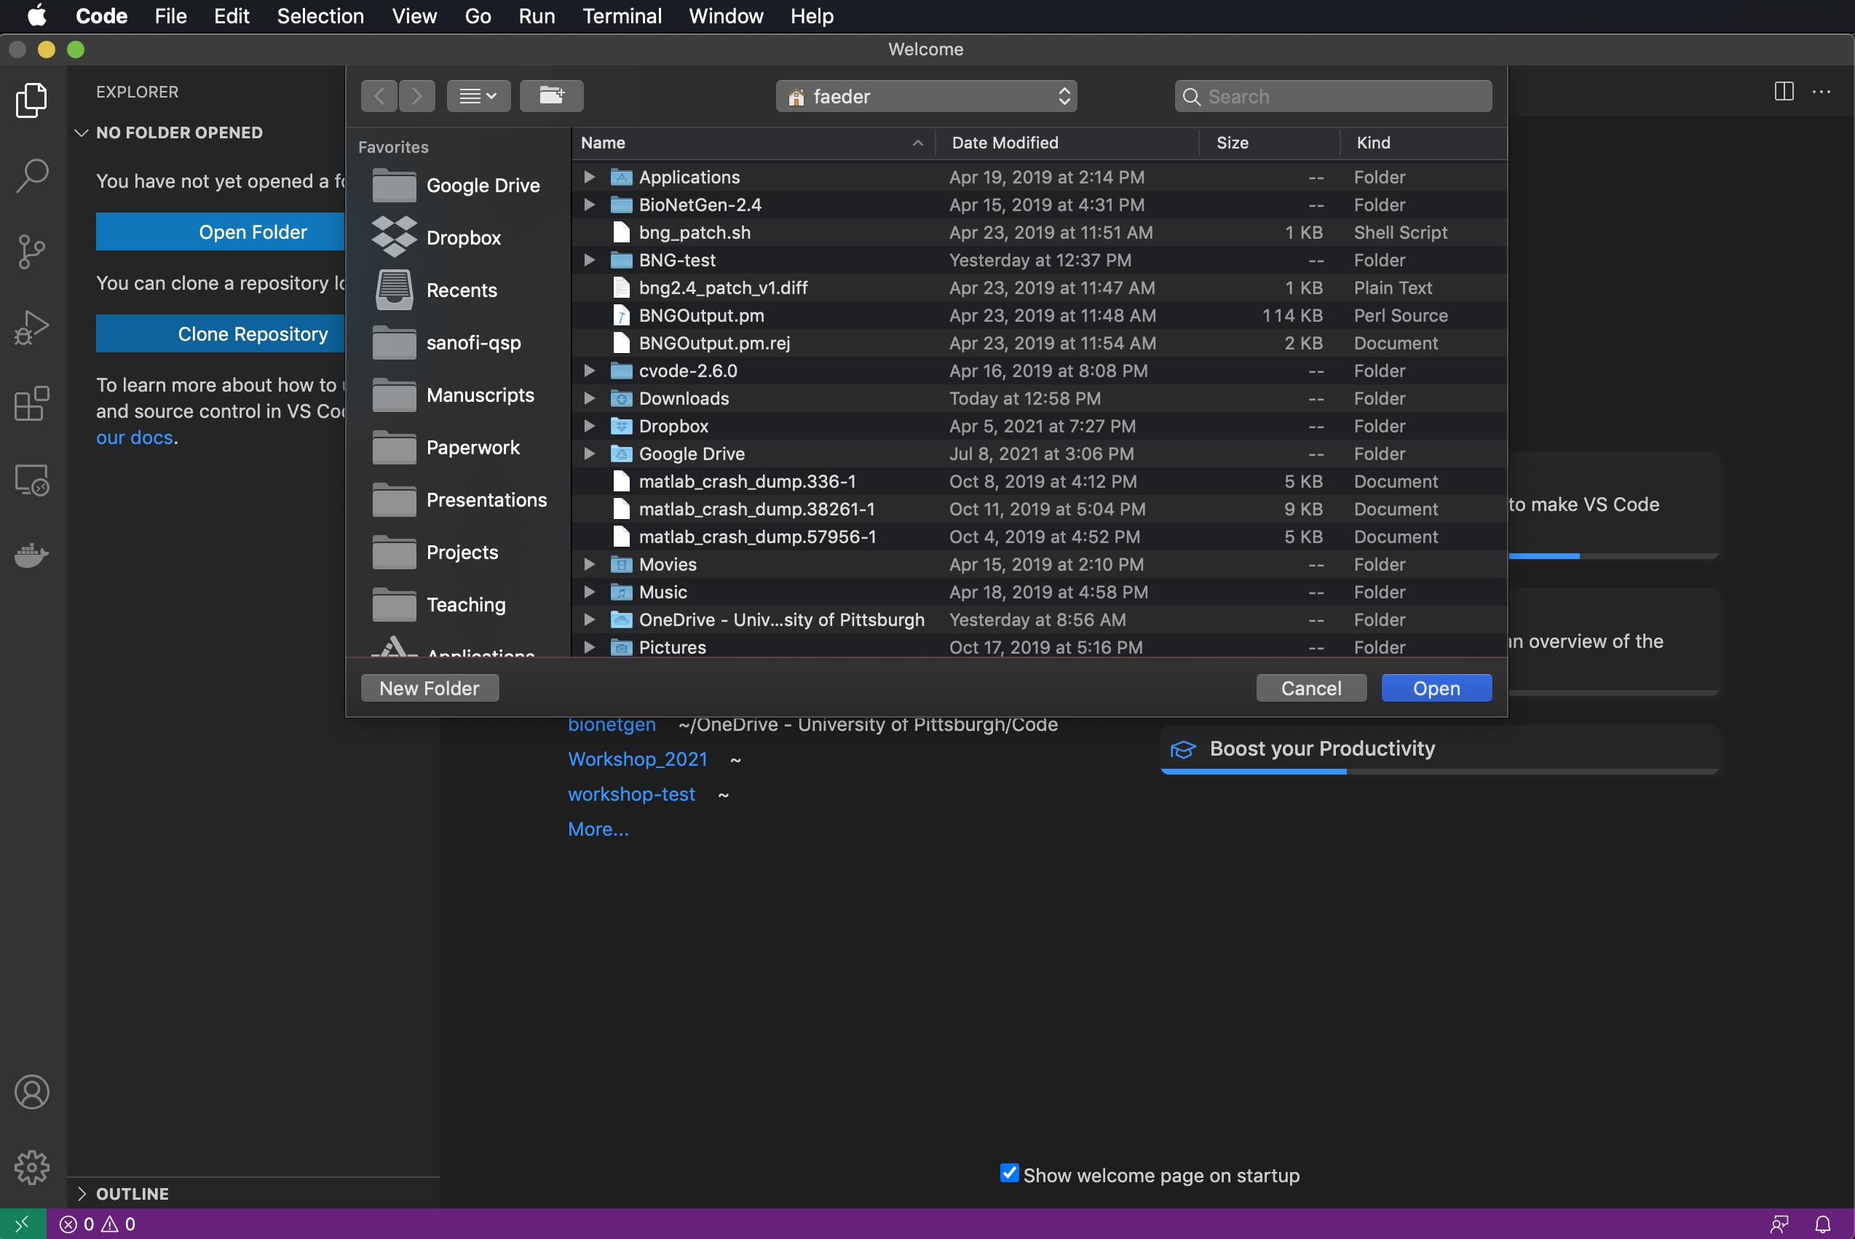
Launching VS Code for the first time
Click on Extensions to make sure BioNetGen is installed.
Click on Explorer to Open a folder or create new one (or click Open in the Welcome page).

Slide 24
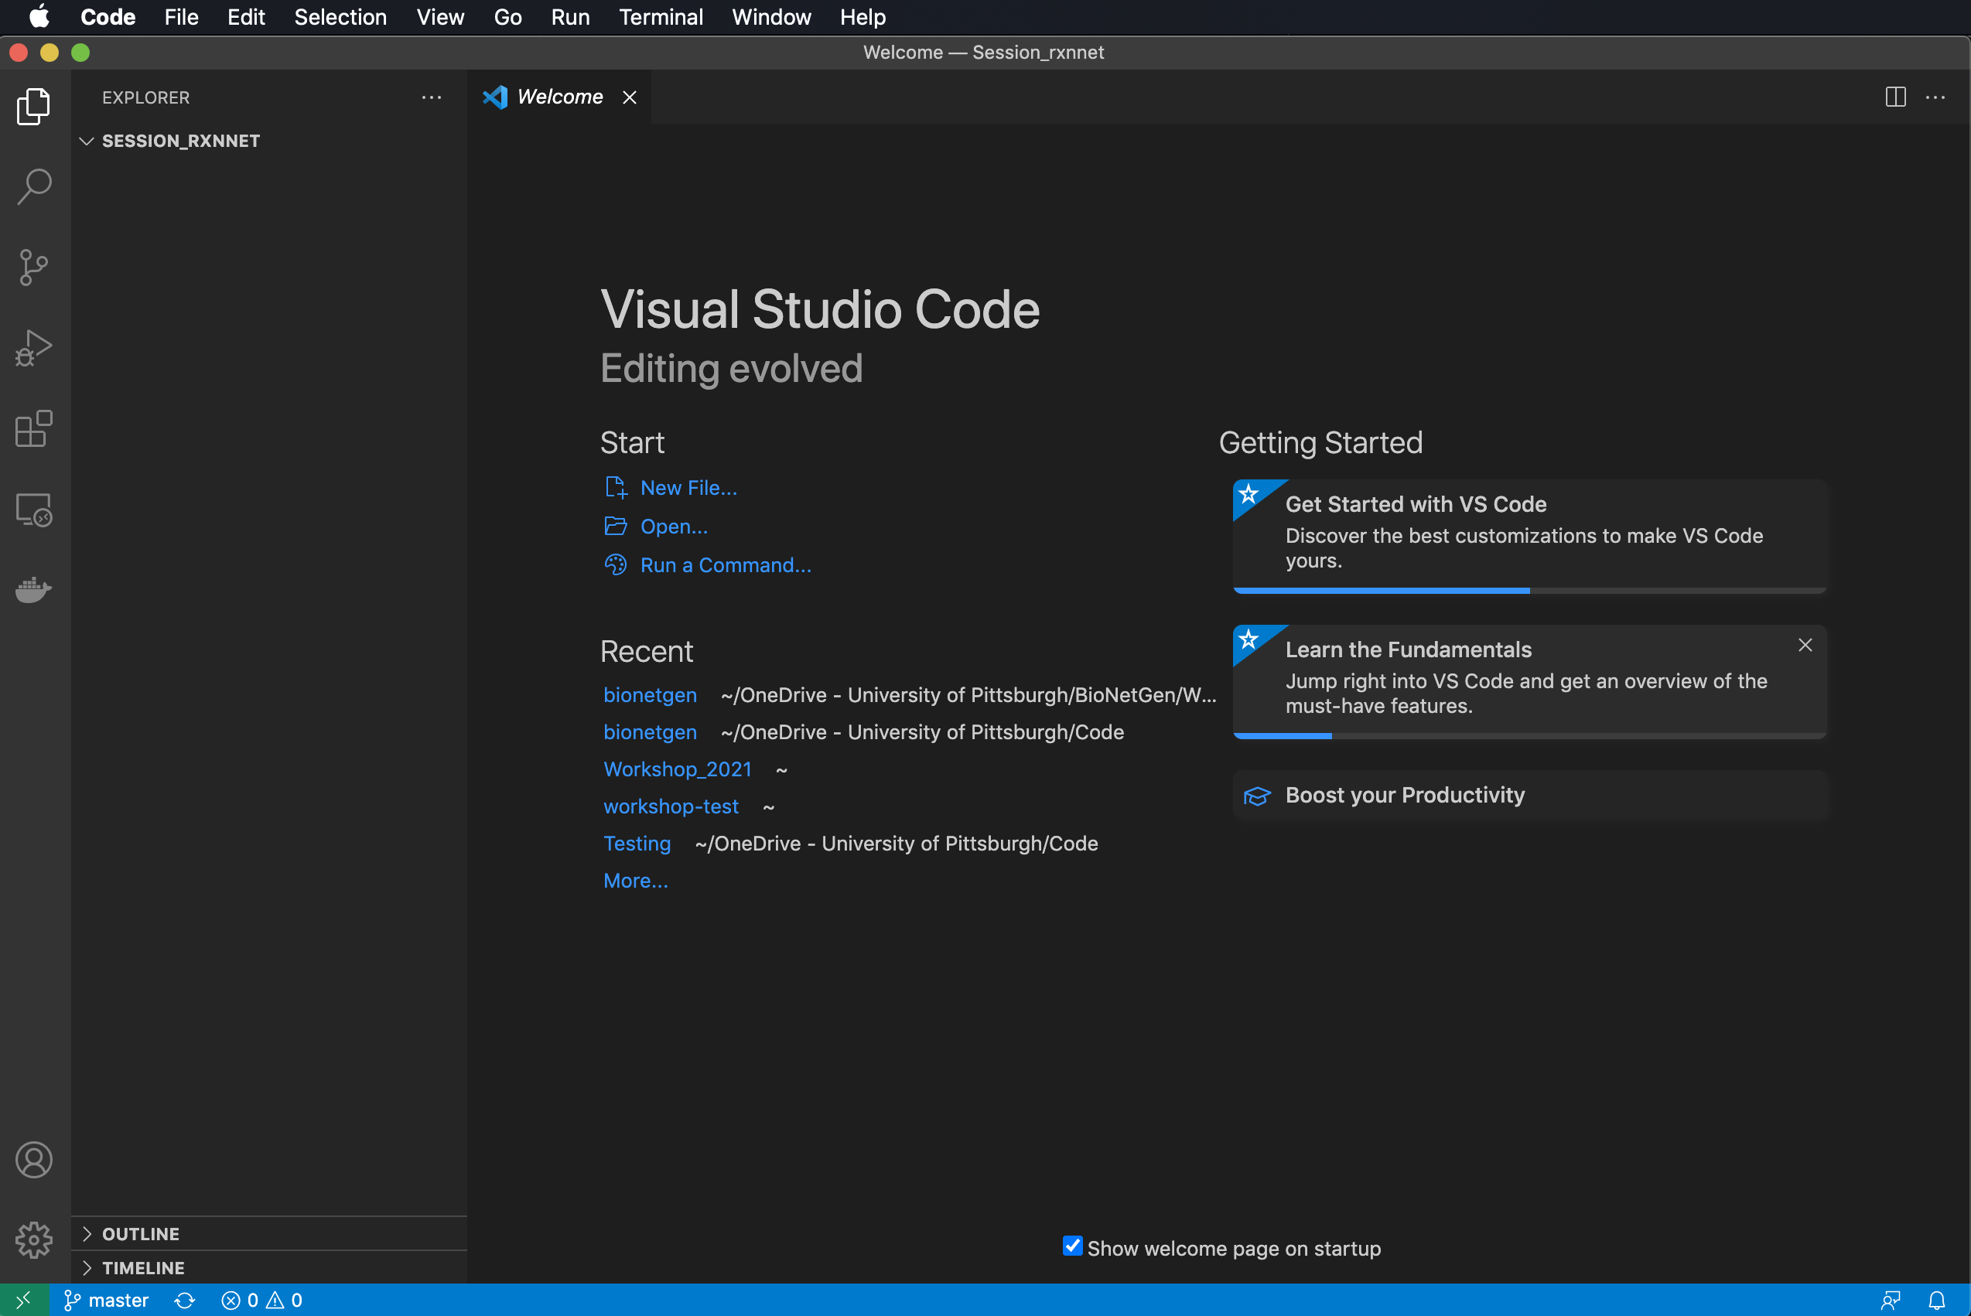
Launching VS Code for the first time
Click on Extensions to make sure BioNetGen is installed.
Click on Explorer to Open a folder or create new one (or click Open in the Welcome page).

Slide 25
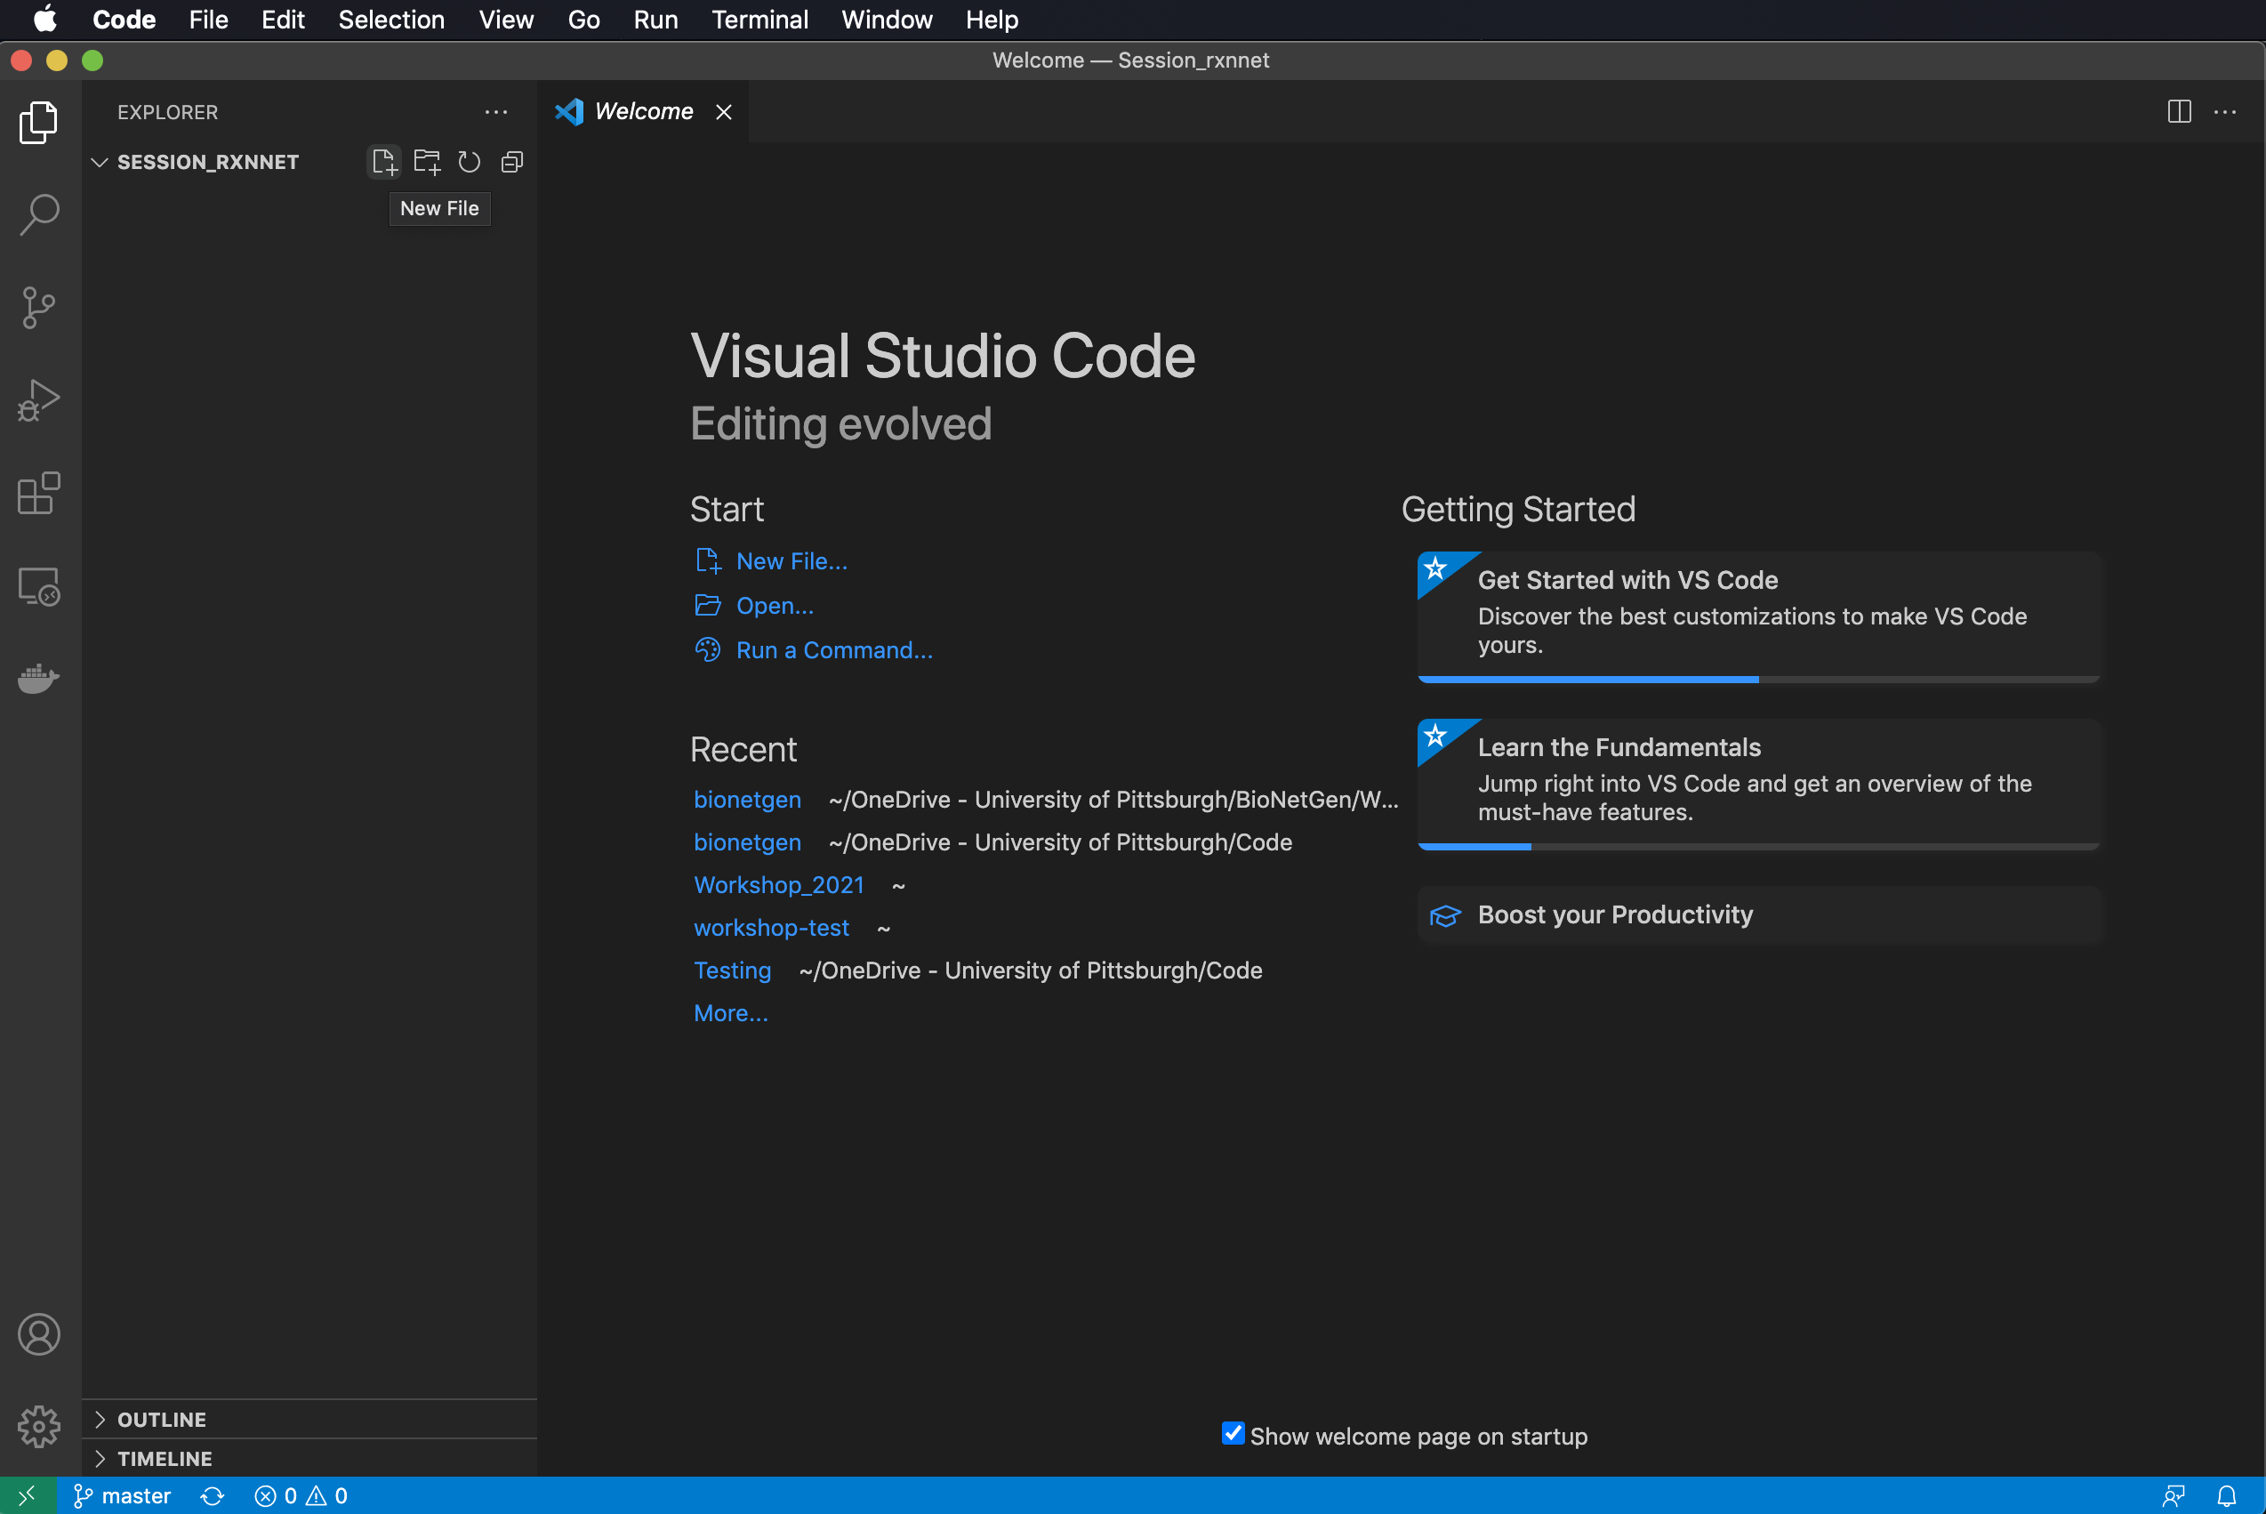
Launching VS Code for the first time
Click on Extensions to make sure BioNetGen is installed.
Click on Explorer to Open a folder or create new one (or click Open in the Welcome page).
Create a new file by mousing over the directory in the Explorer or selecting New File… in Welcome.

Slide 26
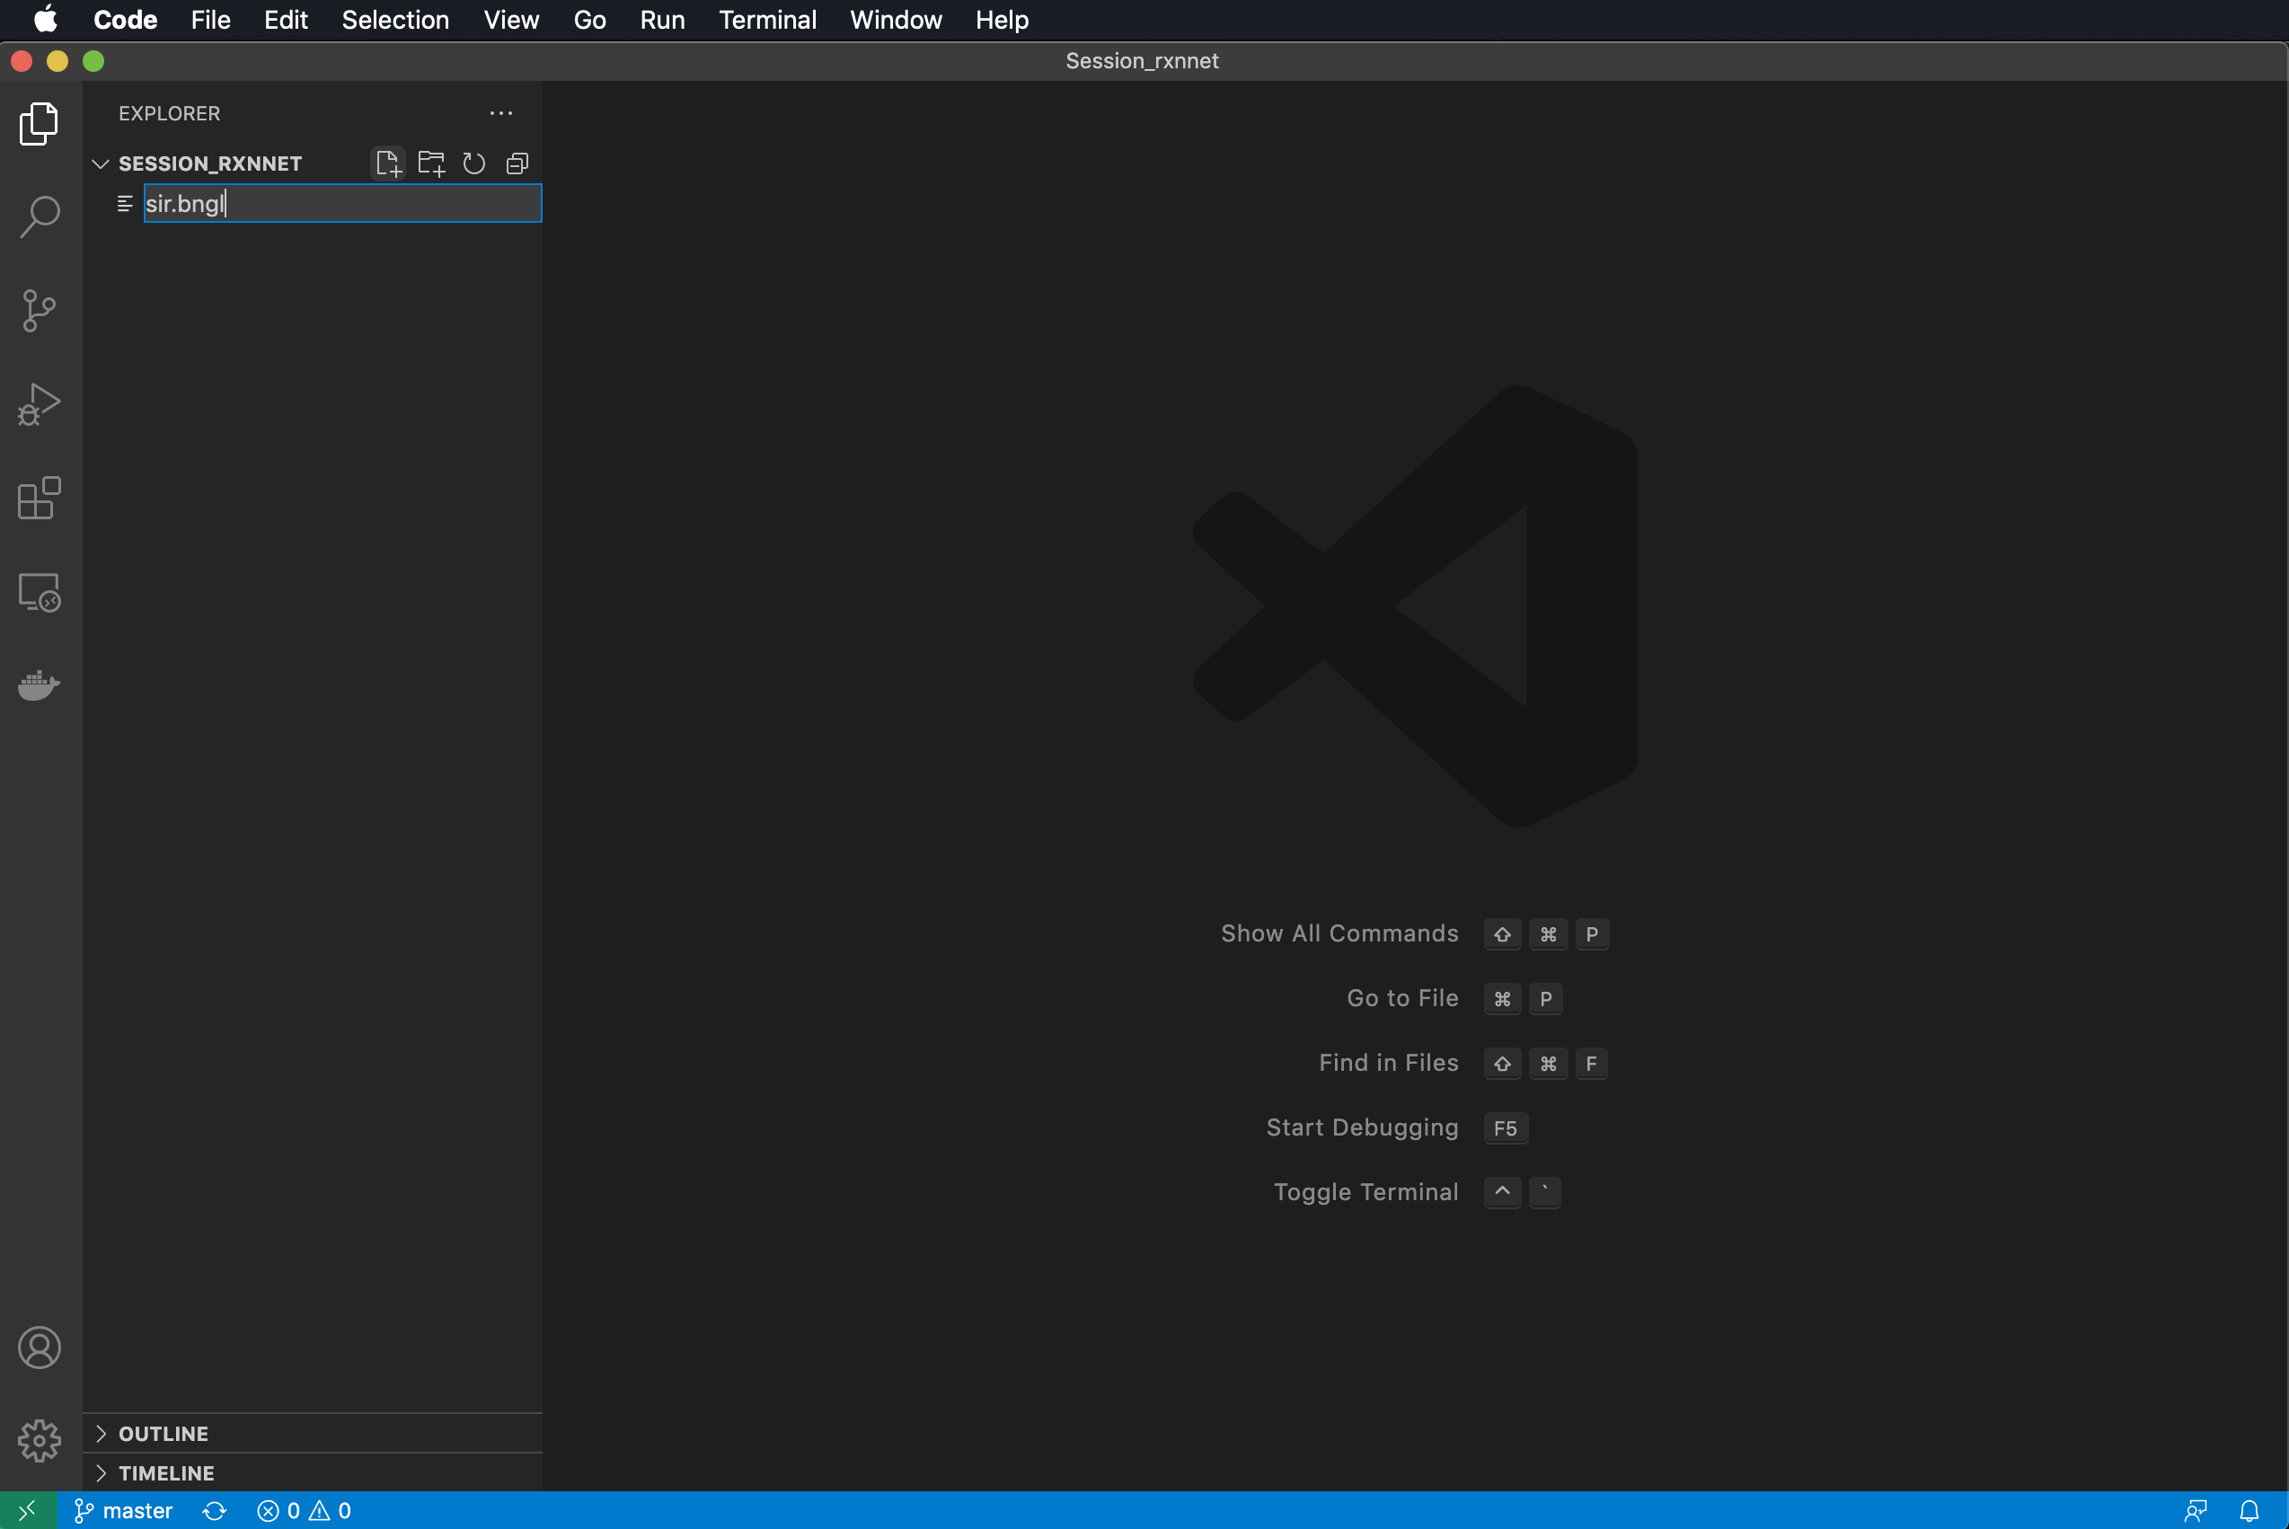
Launching VS Code for the first time
Click on Extensions to make sure BioNetGen is installed.
Click on Explorer to Open a folder or create new one (or click Open in the Welcome page).
Create a new file by mousing over the directory in the Explorer or selecting New File… in Welcome.

Slide 27
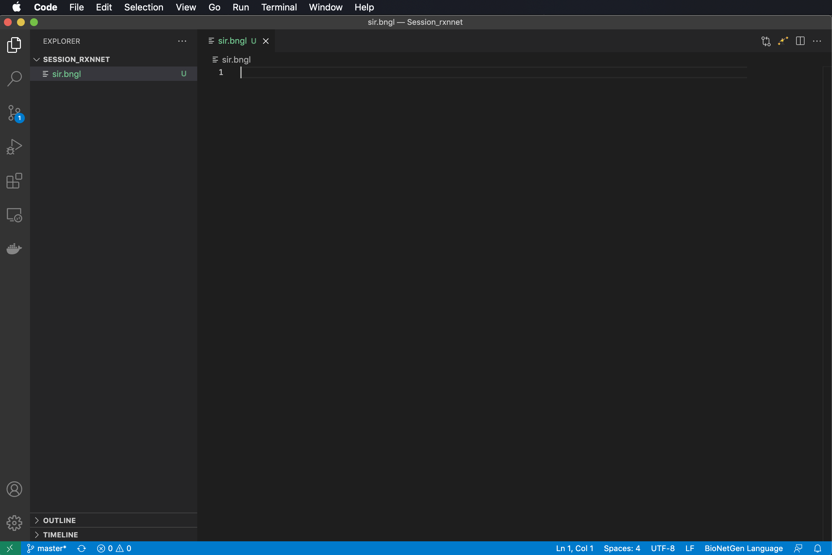
Launching VS Code for the first time
Click on Extensions to make sure BioNetGen is installed.
Click on Explorer to Open a folder or create new one (or click Open in the Welcome page).
Create a new file by mousing over the directory in the Explorer or selecting New File… in Welcome.

Slide 28
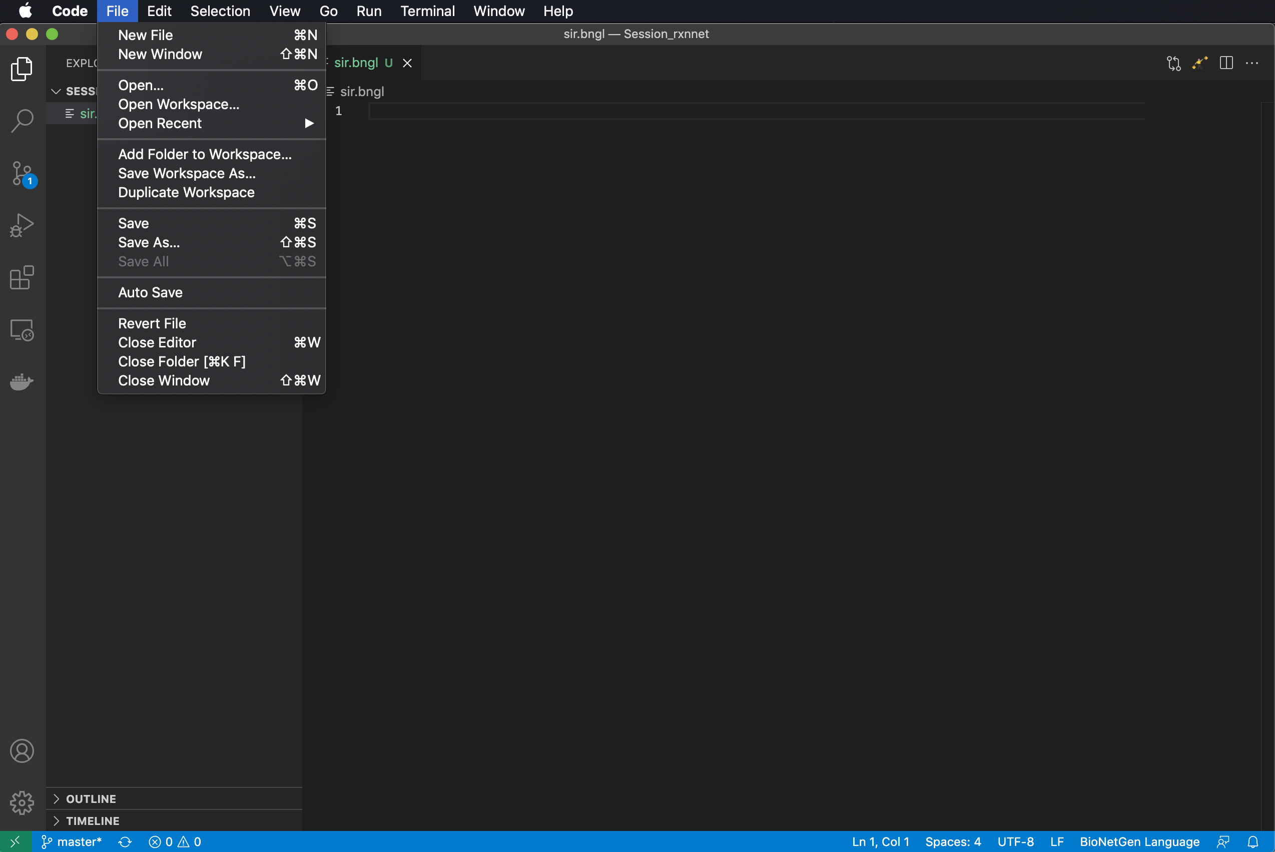
Launching VS Code for the first time
Click on Extensions to make sure BioNetGen is installed.
Click on Explorer to Open a folder or create new one (or click Open in the Welcome page).
Create a new file by mousing over the directory in the Explorer or selecting New File… in Welcome.
(Optional) Turn on Auto Save.

Slide 29
A BioNetGen model is comprised of model blocks and actions
begin model
begin parameters
…
end parameters
begin seed species
…
end seed species
begin observables
…
end observables
begin reaction rules
…
end reaction rules
end model
<actions>
Define model parameters and values
Define model species and initial concentrations/amounts
Model
Define model outputs to be plotted
Define model reactions
Actions
Specify what actions to apply to model, e.g., simulations to perform.

Slide 30
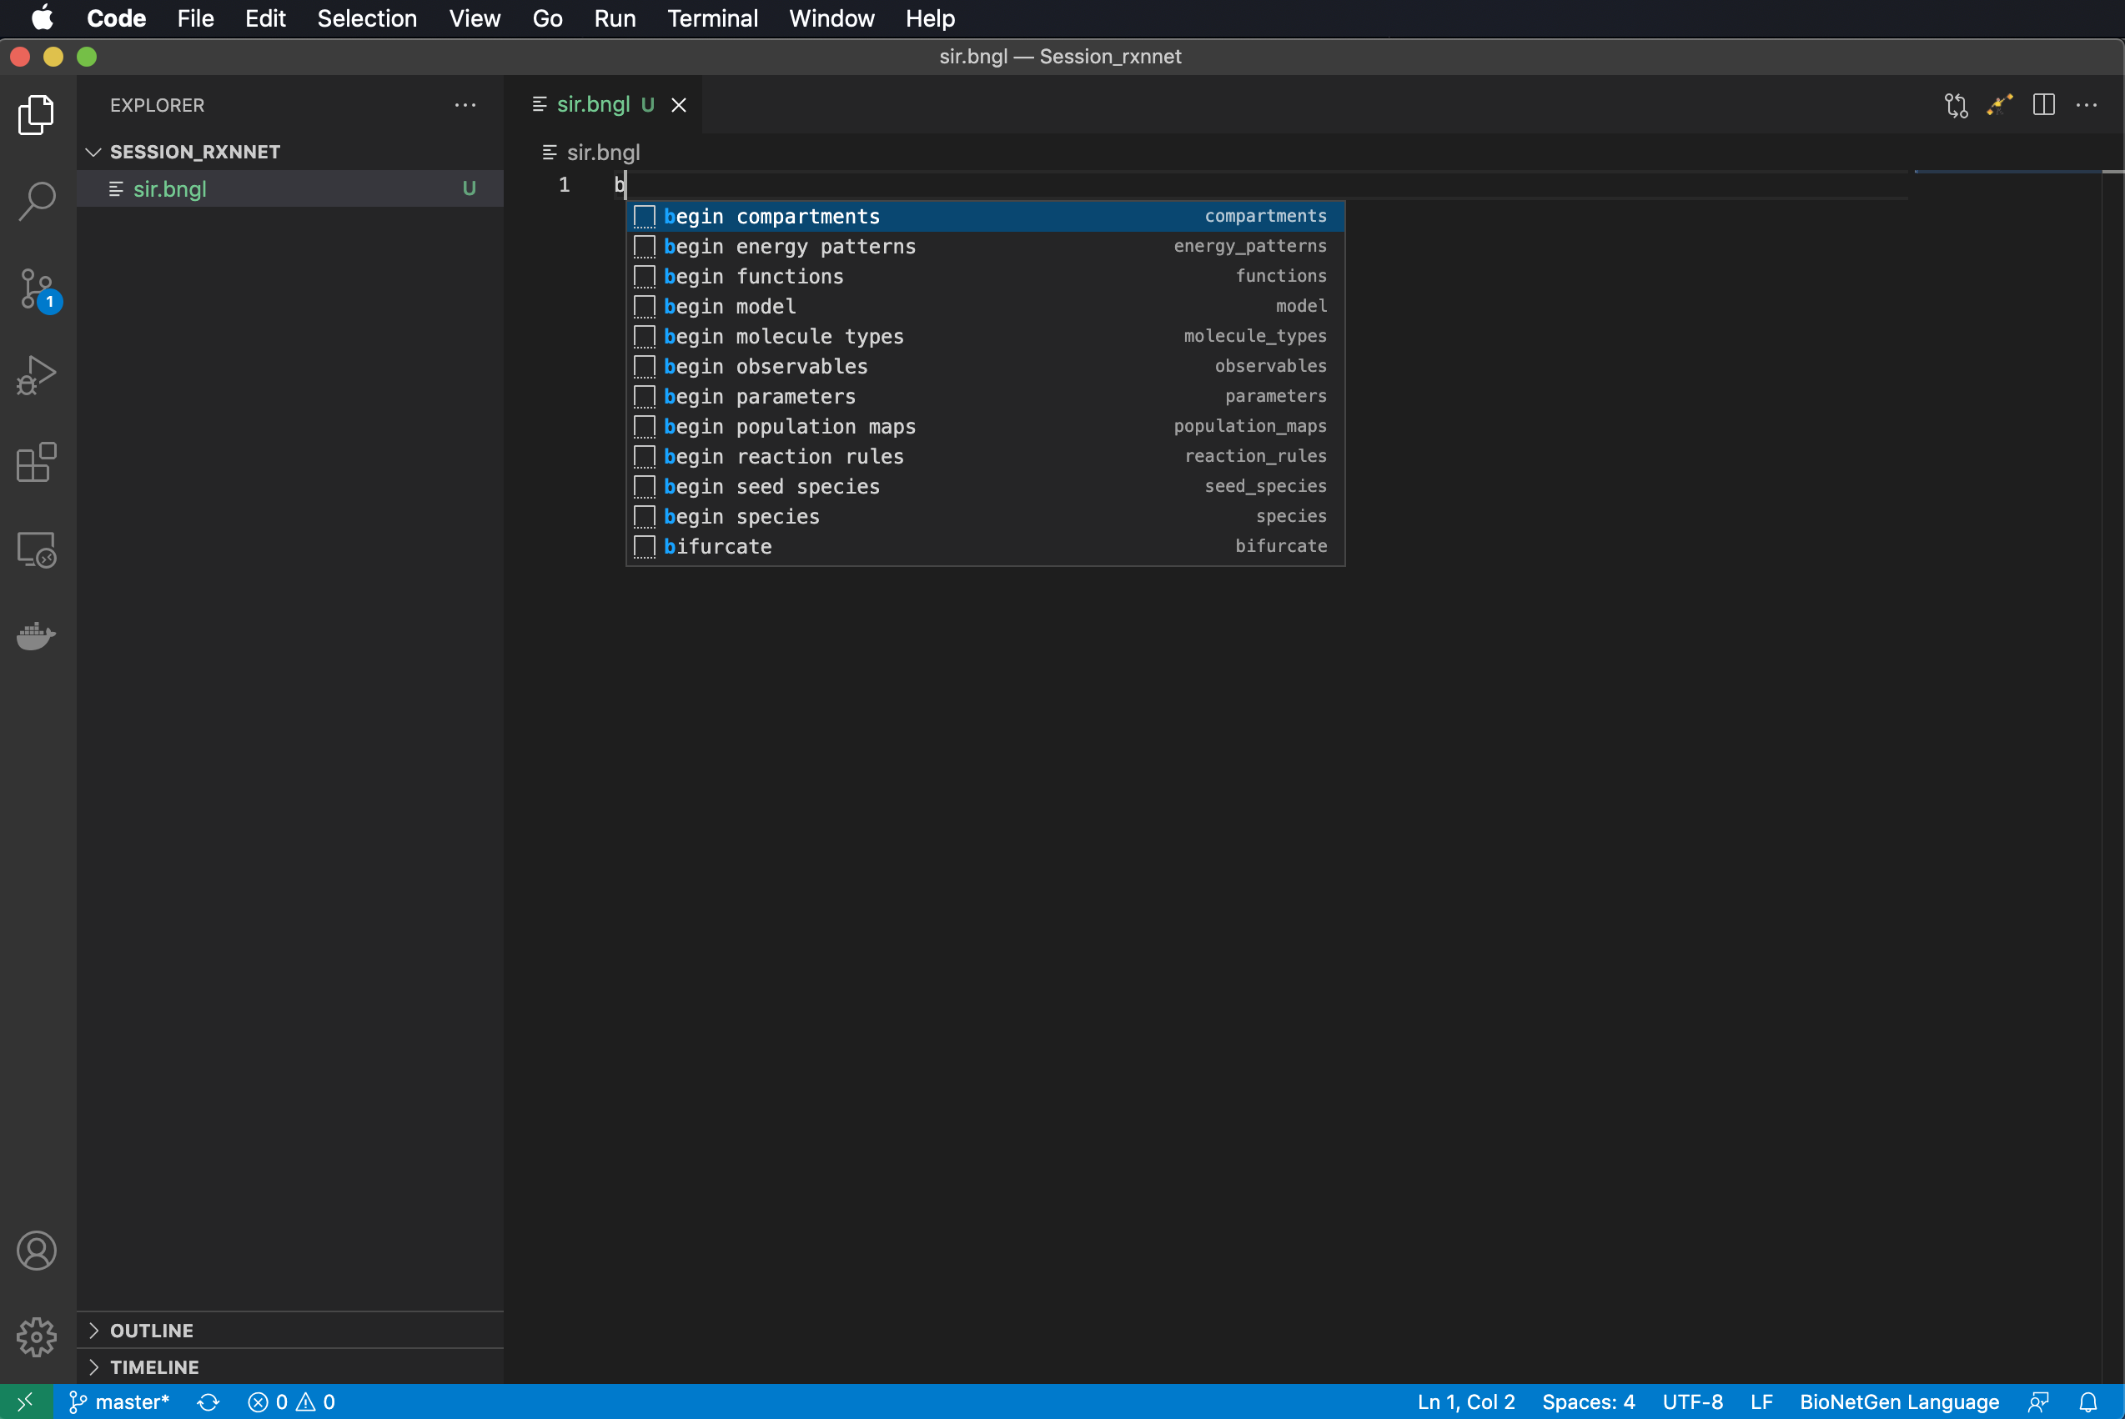
Snippets: Feel the power of the dark side…
Type ‘b’ to begin.

Slide 31
Snippets: Feel the power of the dark side…
Type ‘b’ to begin.
Select ‘begin model’

Slide 32
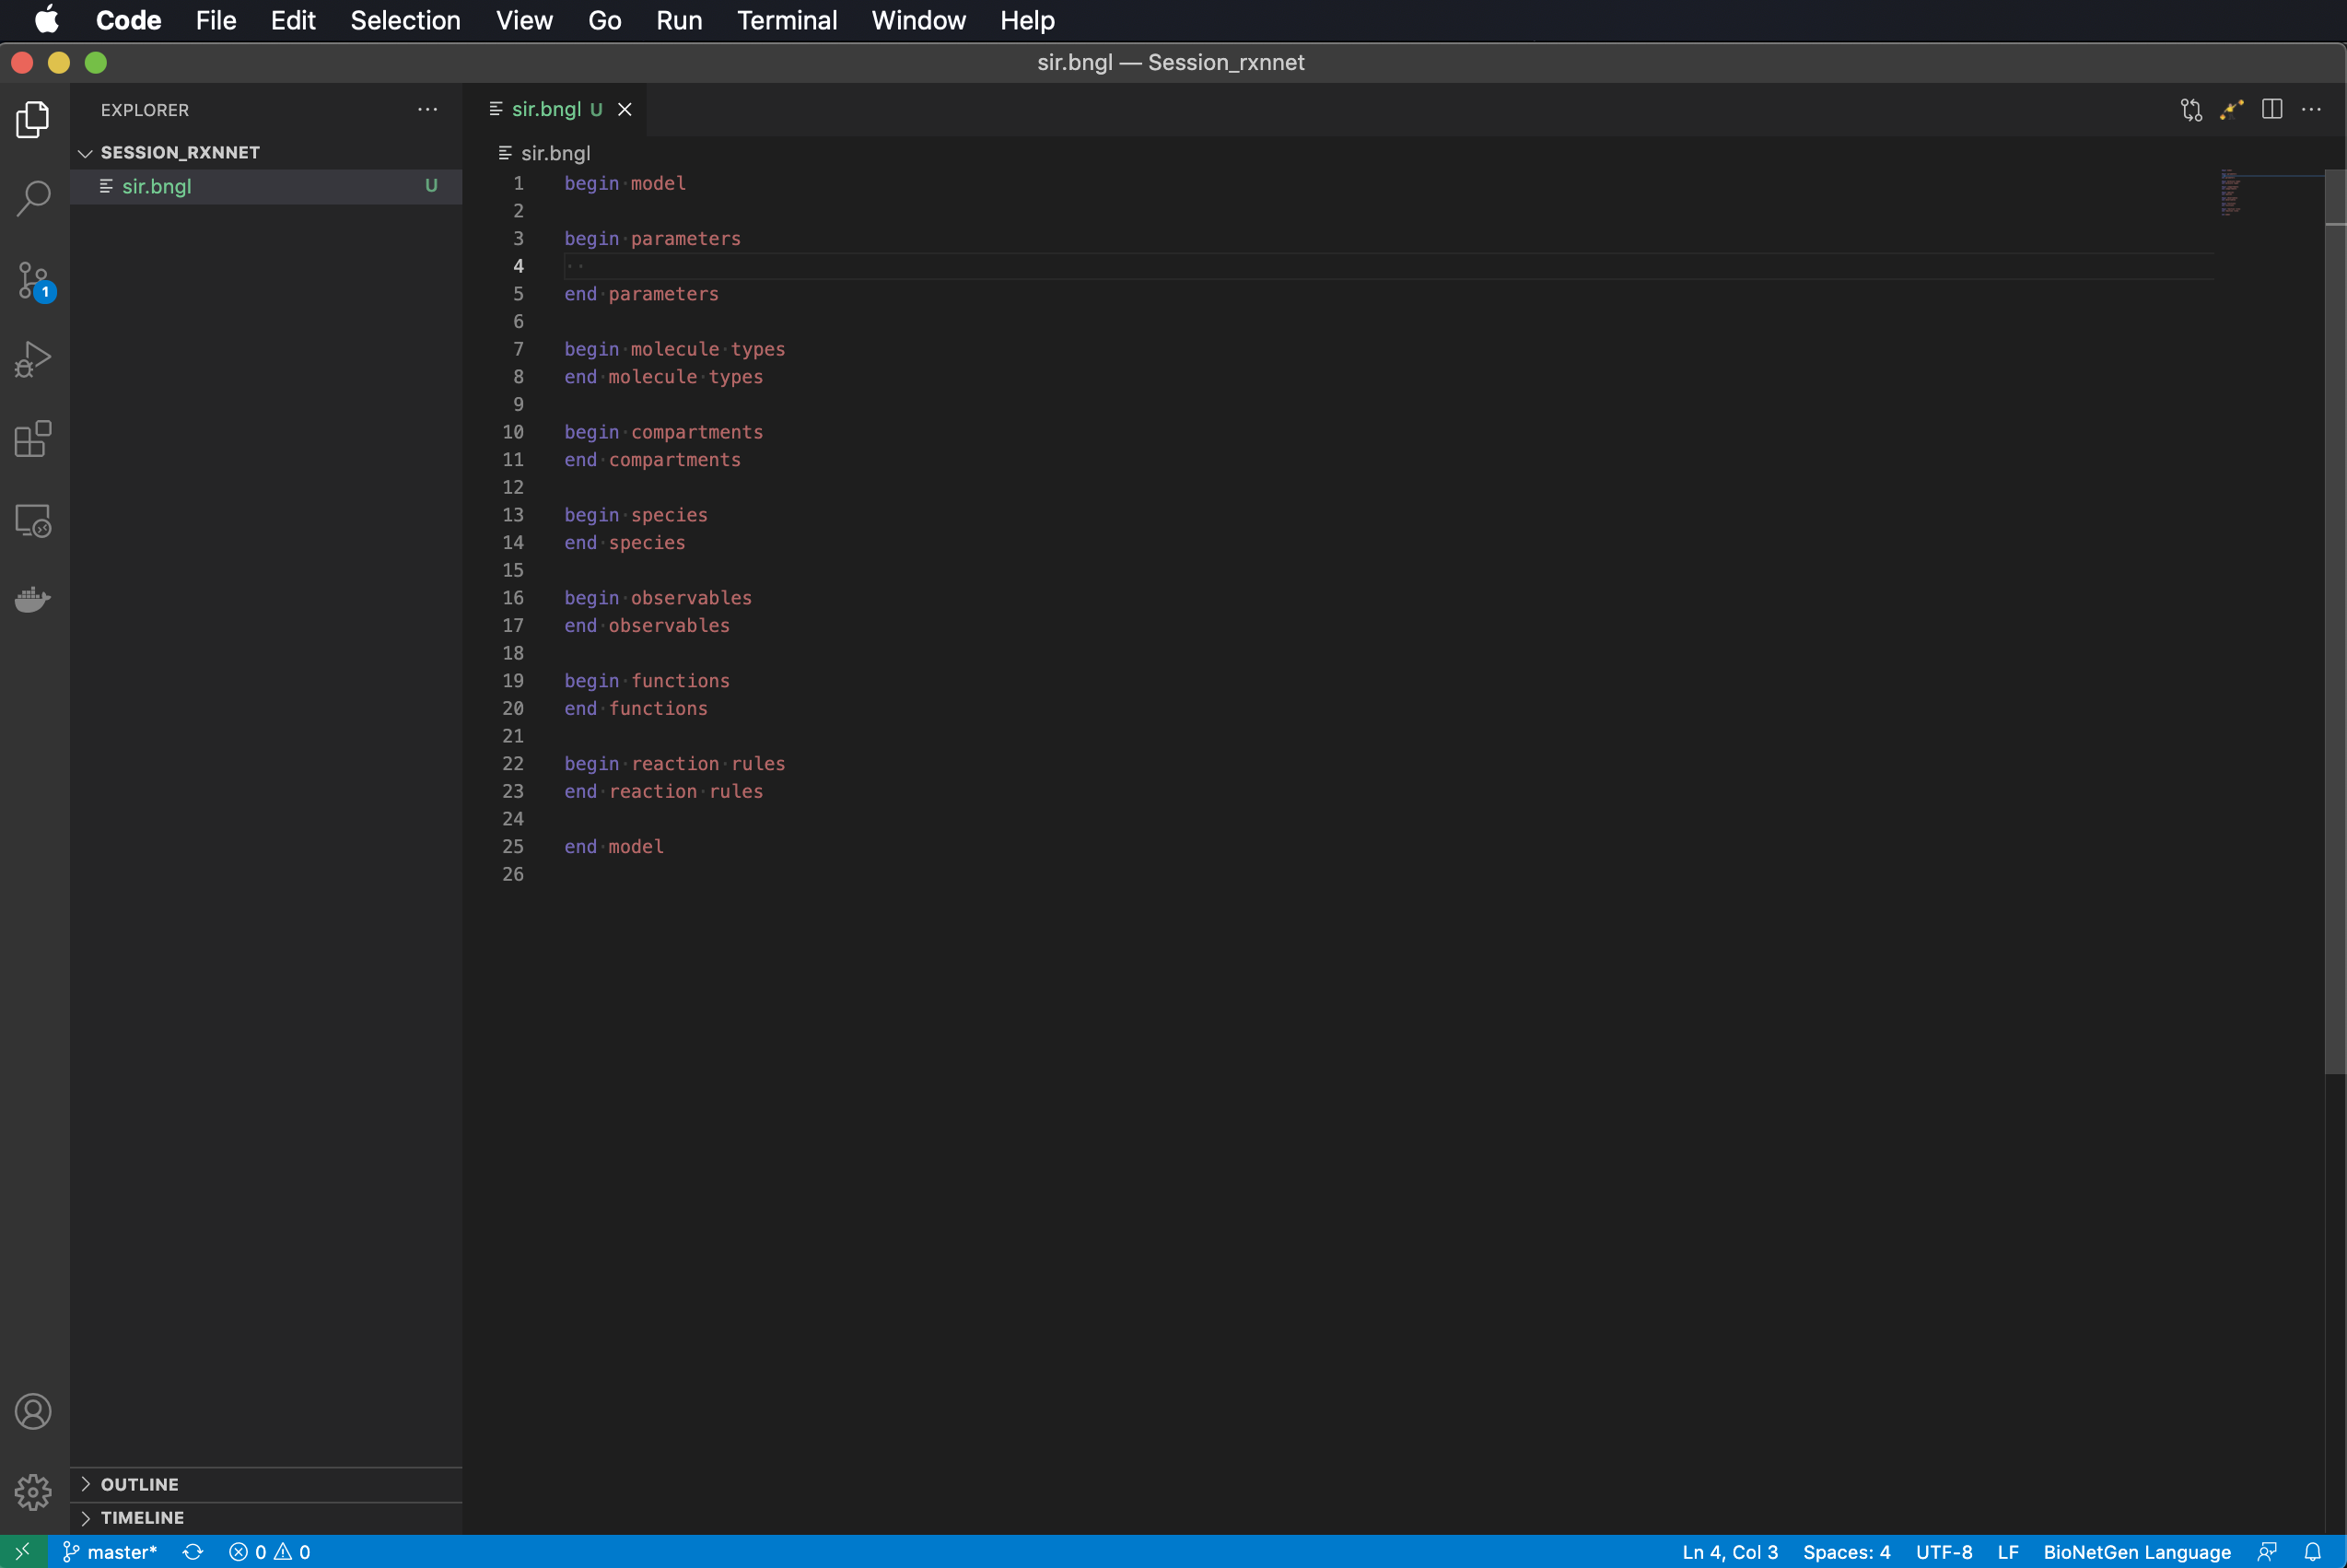
Snippets: Feel the power of the dark side…
Type ‘b’ to begin.
Select ‘begin model’ and some dark magic occurs.

Slide 33

Snippets: Feel the power of the dark side…
Type ‘b’ to begin.
Select ‘begin model’ and some dark magic occurs.
(Optional) Type ctrl-+ or command-+ to make text bigger.

Slide 34

Snippets: Feel the power of the dark side…
Type ‘b’ to begin.
Select ‘begin model’ and some dark magic occurs.
(Optional) Type ctrl-+ or command-+ to make text bigger.
Type ‘p’ and select ‘ParameterLine’.

Slide 35

Snippets: Feel the power of the dark side…
Type ‘b’ to begin.
Select ‘begin model’ and some dark magic occurs.
(Optional) Type ctrl-+ or command-+ to make text bigger.
Type ‘p’ and select ‘ParameterLine’.

Slide 36
Snippets: Feel the power of the dark side…
Type ‘b’ to begin.
Select ‘begin model’ and some dark magic occurs.
(Optional) Type ctrl-+ or command-+ to make text bigger.
Type ‘p’ and select ‘ParameterLine’.
Type an entry for ParameterName and then press Tab to go to ParameterValue.

Slide 37

Snippets: Feel the power of the dark side…
Type ‘b’ to begin.
Select ‘begin model’ and some dark magic occurs.
(Optional) Type ctrl-+ or command-+ to make text bigger.
Type ‘p’ and select ‘ParameterLine’.
Type an entry for ParameterName and then press Tab to go to ParameterValue and enter a number (100).

Slide 38

Snippets: Feel the power of the dark side…
Type ‘b’ to begin.
Select ‘begin model’ and some dark magic occurs.
(Optional) Type ctrl-+ or command-+ to make text bigger.
Type ‘p’ and select ‘ParameterLine’.
Type an entry for ParameterName and then press Tab to go to ParameterValue and enter a number (100).

Slide 39
Snippets: Feel the power of the dark side…
Type ‘b’ to begin.
Select ‘begin model’ and some dark magic occurs.
(Optional) Type ctrl-+ or command-+ to make text bigger.
Type ‘p’ and select ‘ParameterLine’.
Type an entry for ParameterName and then press Tab to go to ParameterValue and enter a number (100).
Repeat for remaining parameters.

Slide 40

Snippets: Feel the power of the dark side…
Type ‘b’ to begin.
Select ‘begin model’ and some dark magic occurs.
(Optional) Type ctrl-+ or command-+ to make text bigger.
Type ‘p’ and select ‘ParameterLine’.
Type an entry for ParameterName and then press Tab to go to ParameterValue and enter a number (100).
Repeat for remaining parameters.

Slide 41
Notes on parameters
Note that on the last line we have defined the infection rate parameter in terms of the other parameters of the model.
Any parameter may be defined by a math expression involving other parameters.
Standard math functions (e.g., sin, cos, exp) may also be used.
Scientific notation for numbers may also be used.

Slide 42

Notes on parameters
Note that on the last line we have defined the infection rate parameter in terms of the other parameters of the model.
Any parameter may be defined by a math expression involving other parameters.
Standard math functions (e.g., sin, cos, exp) may also be used.
Scientific notation for numbers may also be used.

Slide 43

molecule types are used for defining structured species, which are covered in the next presentation

Slide 44

compartments are used for spatial models and will also be discussed in a later presentation

Slide 45

functions are used for defining non-mass action rate laws, which will also be covered later

Slide 46

functions are used for defining non-mass action rate laws, which will also be covered later

Slide 47
species are used to define species that are initially present in the system and their initial concentrations

Slide 48

species are used to define species that are initially present in the system and their initial concentrations
Add line after begin species.
Indent two spaces.
Type ‘sp’
Select SpeciesLine.

Slide 49
species are used to define species that are initially present in the system and their initial concentrations
Add line after begin species.
Indent two spaces.
Type ‘sp’
Select SpeciesLine.

Slide 50

species are used to define species that are initially present in the system and their initial concentrations
Add line after begin species.
Indent two spaces.
Type ‘sp’
Select SpeciesLine.

Slide 51
species are used to define species that are initially present in the system and their initial concentrations
Add line after begin species.
Indent two spaces.
Type ‘sp’
Select SpeciesLine.
Type species pattern (here it is just ‘S’ followed by (). (The parentheses are not mandatory but are needed to make syntax highlighting work.)

Slide 52

species are used to define species that are initially present in the system and their initial concentrations
Add line after begin species.
Indent two spaces.
Type ‘sp’
Select SpeciesLine.
Type species pattern (here it is just ‘S’ followed by (). (The parentheses are not mandatory but are needed to make syntax highlighting work.)

Slide 53
species are used to define species that are initially present in the system and their initial concentrations
Add line after begin species.
Indent two spaces.
Type ‘sp’
Select SpeciesLine.
Type species pattern (here it is just ‘S’ followed by (). (The parentheses are not mandatory but are needed to make syntax highlighting work.)
Type Tab and enter initial amount of S as N-I0.

Slide 54

species are used to define species that are initially present in the system and their initial concentrations
Add line after begin species.
Indent two spaces.
Type ‘sp’
Select SpeciesLine.
Type species pattern (here it is just ‘S’ followed by ‘()’. (The parentheses are not mandatory but are needed to make syntax highlighting work.)
Type Tab and enter initial amount of S as N-I0.

Slide 55
species are used to define species that are initially present in the system and their initial concentrations
Add line after begin species.
Indent two spaces.
Type ‘sp’
Select SpeciesLine.
Type species pattern (here it is just ‘S’ followed by ‘()’. (The parentheses are not mandatory but are needed to make syntax highlighting work.)
Type Tab and enter initial amount of S as N-I0.
Continue for ‘I()’ setting initial amount to I0

Slide 56

species are used to define species that are initially present in the system and their initial concentrations
Add line after begin species.
Indent two spaces.
Type ‘sp’
Select SpeciesLine.
Type species pattern (here it is just ‘S’ followed by ‘()’. (The parentheses are not mandatory but are needed to make syntax highlighting work.)
Type Tab and enter initial amount of S as N-I0.
Continue for ‘I()’ setting initial amount to I0

Slide 57

General comments on species
Initial amounts may be given as number or math expressions involving parameters.
Initial amounts must be >= 0.
Species with zero initial concentration do not need to be listed.
Units of the initial amounts are up to the user, but we strongly recommend using molecule numbers (also needed for compatibility with MCell4).
Block can also be called seed species.

Slide 58
observables define model outputs (quantities that will be included in the .gdat file produced by a simulation)

Slide 59

observables define model outputs (quantities that will be included in the .gdat file produced by a simulation)

Slide 60

observables define model outputs (quantities that will be included in the .gdat file produced by a simulation)
Add line after begin species.
Indent two spaces.
Type ‘o’
Select ObservableLine.

Slide 61

observables define model outputs (quantities that will be included in the .gdat file produced by a simulation)
Add line after begin species.
Indent two spaces.
Type ‘o’
Select ObservableLine.

Slide 62
observables define model outputs (quantities that will be included in the .gdat file produced by a simulation)
Add line after begin species.
Indent two spaces.
Type ‘o’
Select ObservableLine.
Select ’Molecules’ (the type of observable affects how the set of species that match ObservablePattern(s) are summed).

Slide 63

observables define model outputs (quantities that will be included in the .gdat file produced by a simulation)
Add line after begin species.
Indent two spaces.
Type ‘o’
Select ObservableLine.
Select ’Molecules’ (the type of observable affects how the set of species that match ObservablePattern(s) are summed).

Slide 64
observables define model outputs (quantities that will be included in the .gdat file produced by a simulation)
Add line after begin species.
Indent two spaces.
Type ‘o’
Select ObservableLine.
Select ’Molecules’ (the type of observable affects how the set of species that match ObservablePattern(s) are summed).
Type Tab and type ‘S’ followed by Tab and ‘S()’ followed by another Tab and Return to define observable S.

Slide 65

observables define model outputs (quantities that will be included in the .gdat file produced by a simulation)
Add line after begin species.
Indent two spaces.
Type ‘o’
Select ObservableLine.
Select ’Molecules’ (the type of observable affects how the set of species that match ObservablePattern(s) are summed).
Type Tab and type ‘S’ followed by Tab and ‘S()’ followed by another Tab and Return to define observable S.

Slide 66
observables define model outputs (quantities that will be included in the .gdat file produced by a simulation)
Add line after begin species.
Indent two spaces.
Type ‘o’
Select ObservableLine.
Select ’Molecules’ (the type of observable affects how the set of species that match ObservablePattern(s) are summed).
Type Tab and type ‘S’ followed by Tab and ‘S()’ followed by another Tab and Return to define observable S.
Repeat steps 3-6 for I and R.

Slide 67

observables define model outputs (quantities that will be included in the .gdat file produced by a simulation)
Add line after begin species.
Indent two spaces.
Type ‘o’
Select ObservableLine.
Select ’Molecules’ (the type of observable affects how the set of species that match ObservablePattern(s) are summed).
Type Tab and type ‘S’ followed by Tab and ‘S()’ followed by another Tab and Return to define observable S.
Repeat steps 3-6 for I and R.

Slide 68
reaction rules: where the action is (defined)
Syntax
[name:] reactants -> products rateConstant
or
[name:] reactants <-> products rateConstantForward, rateConstantReverse
Define model reactions and rate laws
name is an optional string naming the reaction
arrow indicates whether the reaction is unidirectional (top) or reversible (bottom)
reactants is a list of reactant species separated by ‘+’
products is a list of product species separated by ‘+’
rateConstant is a value, parameter, expression, or function* governing the rate law
*Functions will be introduced later.

Slide 69

reaction rules: where the action is (defined)

Slide 70

reaction rules: where the action is (defined)
Add line after begin reaction rules.
Indent two spaces.
Type ‘ru’
Select RuleLine.

Slide 71

reaction rules: where the action is (defined)
Add line after begin reaction rules.
Indent two spaces.
Type ‘ru’
Select RuleLine.

Slide 72
reaction rules: where the action is (defined)
Add line after begin reaction rules.
Indent two spaces.
Type ‘ru’
Select RuleLine.
Name the reaction ‘R1’ and encode the reaction ‘S + I -> I + I’ with rate constant ‘b’.

Slide 73

reaction rules: where the action is (defined)
Add line after begin reaction rules.
Indent two spaces.
Type ‘ru’
Select RuleLine.
Name the reaction ‘R1’ and encode the reaction ‘S + I -> I + I’ with rate constant ‘b’.

Slide 74
reaction rules: where the action is (defined)
Add line after begin reaction rules.
Indent two spaces.
Type ‘ru’
Select RuleLine.
Name the reaction ‘R1’ and encode the reaction ‘S + I -> I + I’ with rate constant ‘b’.
Add a second reaction ‘I -> R’ with rate constant g.

Slide 75

reaction rules: where the action is (defined)
Add line after begin reaction rules.
Indent two spaces.
Type ‘ru’
Select RuleLine.
Name the reaction ‘R1’ and encode the reaction ‘S + I -> I + I’ with rate constant ‘b’.
Add a second reaction ‘I -> R’ with rate constant g.

Slide 76
actions: where the real action is
Go after the end model line.

Slide 77

actions: where the real action is
Go after the end model line.

Slide 78
actions: where the real action is
Go after the end model line.
Key actions are
generate_network
Generate all possible species and reactions in a model
simulate
Generate a model trajectory using one of the built-in methods

Slide 79

actions: where the real action is
Type ‘g’
Select generate_network and set the overwrite option to ‘1’.

Slide 80

actions: where the real action is
Type ‘g’
Select generate_network and set the overwrite option to ‘1’.

Slide 81
actions: where the real action is
Type ‘g’
Select generate_network and set the overwrite option to ‘1’.
Type ‘si’ and select simulate.

Slide 82

actions: where the real action is
Type ‘g’
Select generate_network and set the overwrite option to ‘1’.
Type ‘si’ and select simulate.

Slide 83

actions: where the real action is
Type ‘g’
Select generate_network and set the overwrite option to ‘1’.
Type ‘si’ and select simulate.
Select ‘ode’ and set t_end to 30 and n_steps to 200.

Slide 84

actions: where the real action is
Type ‘g’
Select generate_network and set the overwrite option to ‘1’.
Type ‘si’ and select simulate.
Select ‘ode’ and set t_end to 30 and n_steps to 200.

Slide 85
actions: where the real action is
Type ‘g’
Select generate_network and set the overwrite option to ‘1’.
Type ‘si’ and select simulate.
Select ‘ode’ and set t_end to 30 and n_steps to 200. These parameters determine the final time point of the trajectory (starting from 0) and the number of steps to take in between.

Slide 86
actions: where the real action is
Type ‘g’
Select generate_network and set the overwrite option to ‘1’.
Type ‘si’ and select simulate.
Select ‘ode’ and set t_end to 30 and n_steps to 200. These parameters determine the final time point of the trajectory (starting from 0) and the number of steps to take in between.
Yay! Now we are ready to run simulation. Click on “flagman” to execute the .bngl file.

Slide 87

Many things happen when we execute the model

Slide 88
Many things happen when we execute the model
New files are generated and displayed in the Explorer window.

Slide 89
Many things happen when we execute the model
New files are generated and displayed in the Explorer window.
The files are placed in a directory named according to the date and time.

Slide 90
Many things happen when we execute the model
New files are generated and displayed in the Explorer window.
The files are placed in a directory named according to the date and time.
The .gdat file created by the simulation is opened in a new window.

Slide 91
Many things happen when we execute the model
New files are generated and displayed in the Explorer window.
The files are placed in a directory named according to the date and time.
The .gdat file created by the simulation is opened in a new window.
Plotting buttons appear.

Slide 92
Many things happen when we execute the model
New files are generated and displayed in the Explorer window.
The files are placed in a directory named according to the date and time.
The .gdat file created by the simulation is opened in a new window.
Plotting buttons appear.
The TERMINAL panel shows the output of commands used to execute the model and actions requested in the .bngl file.

Slide 93
Interactive plotting
Clicking on the first plot icon brings up an interactive plot of the .gdat file data.

Slide 94

Interactive plotting
Clicking on the first plot icon brings up an interactive plot of the .gdat file data.

Slide 95
Interactive plotting
Clicking on the first plot icon brings up an interactive plot of the .gdat file data.
Interactive features include
zooming in and out
optional log scaling of either axis
turning on and off display of each variable
exporting plots to both png (image) and svg (vector) formats.

Slide 96
Interactive plotting
Clicking on the first plot icon brings up an interactive plot of the .gdat file data.
Interactive features include
zooming in and out
optional log scaling of either axis
turning on and off display of each variable
exporting plots to both png (image) and svg (vector) formats.
The .cdat file can also be plotted. It shows timecourses of all model species.

Slide 97

Interactive plotting
Clicking on the first plot icon brings up an interactive plot of the .gdat file data.
Interactive features include
zooming in and out
optional log scaling of either axis
turning on and off display of each variable
exporting plots to both png (image) and svg (vector) formats.
The .cdat file can also be plotted. It shows timecourses of all model species.

Slide 98

Interactive plotting
Clicking on the first plot icon brings up an interactive plot of the .gdat file data.
Interactive features include
zooming in and out
optional log scaling of either axis
turning on and off display of each variable
exporting plots to both png (image) and svg (vector) formats.
The .cdat file can also be plotted. It shows timecourses of all model species.

Slide 99

Investigating the effect of changing the parameter R0
Change parameter R0 from 2.5 to 1.1 and re-run the simulation

Slide 100

Investigating the effect of changing the parameter R0
Change parameter R0 from 2.5 to 1.1 and re-run the simulation

Slide 101

Investigating the effect of changing the parameter R0
Change parameter R0 from 2.5 to 1.1 and re-run the simulation
A new folder appears along with a new .gdat file.

Slide 102
Investigating the effect of changing the parameter R0
Change parameter R0 from 2.5 to 1.1 and re-run the simulation
A new folder appears along with a new .gdat file.
Plotting this data reveals altered time course.

Slide 103

Investigating the effect of changing the parameter R0
Change parameter R0 from 2.5 to 1.1 and re-run the simulation
A new folder appears along with a new .gdat file.
Plotting this data reveals altered time course.

Slide 104
Investigating the effect of changing the parameter R0
Change parameter R0 from 2.5 to 1.1 and re-run the simulation
A new folder appears along with a new .gdat file.
Plotting this data reveals altered time course.
We can compare the trajectories side-by-side by splitting the Editor window and moving this plot to the new panel.

Slide 105

Investigating the effect of changing the parameter R0
Change parameter R0 from 2.5 to 1.1 and re-run the simulation
A new folder appears along with a new .gdat file.
Plotting this data reveals altered time course.
We can compare the trajectories side-by-side by splitting the Editor window and moving this plot to the new panel.

Slide 106

Investigating the effect of changing the parameter R0
Change parameter R0 from 2.5 to 1.1 and re-run the simulation
A new folder appears along with a new .gdat file.
Plotting this data reveals altered time course.
We can compare the trajectories side-by-side by splitting the Editor window, moving this plot to the new panel, and clicking the autoscale buttons in both windows to make graphs fit.

Slide 107

parameter_scan action
We want to study the effect of varying R0 over a range of values.

Slide 108
parameter_scan action
We want to study the effect of varying R0 over a range of values.
Before we modify our model, let’s make a copy.

Slide 109

parameter_scan action
We want to study the effect of varying R0 over a range of values.
Before we modify our model, let’s make a copy.
Right click the .bngl file and select Copy.

Slide 110
parameter_scan action
We want to study the effect of varying R0 over a range of values.
Before we modify our model, let’s make a copy.
Right click the .bngl file and select Copy.

Slide 111

parameter_scan action
We want to study the effect of varying R0 over a range of values.
Before we modify our model, let’s make a copy.
Right click the .bngl file and select Copy.
Right click in the area below and select Paste.

Slide 112

parameter_scan action
We want to study the effect of varying R0 over a range of values.
Before we modify our model, let’s make a copy.
Right click the .bngl file and select Copy.
Right click in the area below and select Paste.
Rename file.

Slide 113

parameter_scan action
We want to study the effect of varying R0 over a range of values.
Before we modify our model, let’s make a copy.
Right click the .bngl file and select Copy.
Right click in the area below and select Paste.
Rename file.

Slide 114
parameter_scan action
We want to study the effect of varying R0 over a range of values.
Before we modify our model, let’s make a copy.
Right click the .bngl file and select Copy.
Right click in the area below and select Paste.
Rename file.
Delete (or comment out by adding ‘#’ to start of line) simulate action and add parameter_scan action.

Slide 115

parameter_scan action
We want to study the effect of varying R0 over a range of values.
Before we modify our model, let’s make a copy.
Right click the .bngl file and select Copy.
Right click in the area below and select Paste.
Rename file.
Delete (or comment out by adding ‘#’ to start of line) simulate action and add parameter_scan action.

Slide 116

parameter_scan action
We want to study the effect of varying R0 over a range of values.
Before we modify our model, let’s make a copy.
Right click the .bngl file and select Copy.
Right click in the area below and select Paste.
Rename file.
Delete (or comment out by adding ‘#’ to start of line) simulate action and add parameter_scan action.

Slide 117

parameter_scan action
We want to study the effect of varying R0 over a range of values.
Before we modify our model, let’s make a copy.
Right click the .bngl file and select Copy.
Right click in the area below and select Paste.
Rename file.
Delete (or comment out by adding ‘#’ to start of line) simulate action and add parameter_scan action.
Fill in remaining items.

Slide 118

parameter_scan action
We want to study the effect of varying R0 over a range of values.
Before we modify our model, let’s make a copy.
Right click the .bngl file and select Copy.
Right click in the area below and select Paste.
Rename file.
Delete (or comment out by adding ‘#’ to start of line) simulate action and add parameter_scan action.
Fill in remaining items.
Run BNG.

Slide 119

parameter_scan action
We want to study the effect of varying R0 over a range of values.
Before we modify our model, let’s make a copy.
Right click the .bngl file and select Copy.
Right click in the area below and select Paste.
Rename file.
Delete (or comment out by adding ‘#’ to start of line) simulate action and add parameter_scan action.
Fill in remaining items.
Run BNG.
Click on sir_scan/… directory and on sir_scan_R0.scan file (note that I closed the TERMINAL window and autoscaled the plot).

Slide 120
Investigating the effect of population size
Substantial fraction infected below R0=1
Exercise: Investigate the effect of increasing N to 10,000

Slide 121

Investigating the effect of population size
Infection below R0=1 exhibits much less penetration for a larger population size (for the same number of initial infections).
Exercise: Investigate the effect of increasing N to 10,000

Slide 122

Investigating stochastic effects using the ssa method
In order to perform a stochastic simulation we need to check that:
Species concentrations (and rate constants) are in counts, e.g., molecules, individuals, etc.
Initial concentrations have integer values (BNG will automatically round to the nearest integer, but if this is zero the model may not behave as expected (see points and 2).

Slide 123
Investigating stochastic effects using the ssa method
In order to perform a stochastic simulation we need to check that:
Species concentrations (and rate constants) are in counts, e.g., molecules, individuals, etc.
Initial concentrations have integer values (BNG will automatically round to the nearest integer, but if this is zero the model may not behave as expected (see points and 2).

Slide 124

Investigating stochastic effects using the ssa method
We will set R0 to 1.2 and modify the simulate command as follows:

Slide 125

Investigating stochastic effects using the ssa method
We will set R0 to 1.2 and modify the simulate command as follows:
Change method from ode to ssa.

Slide 126

Investigating stochastic effects using the ssa method
We will set R0 to 1.2 and modify the simulate command as follows:
Change method from ode to ssa.

Slide 127
Investigating stochastic effects using the ssa method
We will set R0 to 1.2 and modify the simulate command as follows:
Change method from ode to ssa.
Add the parameter seed to the arguments and set its value to 1.

Slide 128

Investigating stochastic effects using the ssa method
We will set R0 to 1.2 and modify the simulate command as follows:
Change method from ode to ssa.
Add the parameter seed to the arguments and set its value to 1.
This is the value used to seed the random number generator and ensures that we will get the same trajectory each time we run the simulation, which is useful for debugging models.

Slide 129

Investigating stochastic effects using the ssa method
Here are plots showing stochastic trajectories for three different seed values.

Slide 130
Investigating stochastic effects using the ssa method
Here are plots showing stochastic trajectories for three different seed values.
Exercise:
Make a similar set of plots.
What happens to the trajectories when you increase R0 to 1.4?

Slide 131
Compare effects of simulation type in one run using saveConcentrations / resetConcentrations.
Saves initial concentration values for future use.
# Actions
saveConcentrations()
simulate({method=>"ode",suffix=>"ode",t_end=>30,n_steps=>200})
resetConcentrations()
simulate({method=>"ssa",suffix=>"ssa",t_end=>30,n_steps=>200,seed=>1})
Restores the initial concentrations from before the ODE simulation.

Slide 132
Compare effects of simulation type in one run using saveConcentrations / resetConcentrations.
# Actions
saveConcentrations()
simulate({method=>"ode",suffix=>"ode",t_end=>30,n_steps=>200})
resetConcentrations()
simulate({method=>"ssa",suffix=>"ssa",t_end=>30,n_steps=>200,seed=>1})
Adds this string to output file names for each simulation so that results can be plotted separately .

Slide 133
Convert SIR model into predator-prey model (Lotka-Volterra)
begin reaction rules
S -> S + S k1
S + I -> I + I k2
I -> 0 k3
end reaction rules

Slide 134
Convert SIR model into predator-prey model (Lotka-Volterra)
begin reaction rules
S -> S + S k1
S + I -> I + I k2
I -> 0 k3
end reaction rules
Added growth reaction for S (prey).

Slide 135

Convert SIR model into predator-prey model (Lotka-Volterra)
begin reaction rules
S -> S + S k1
S + I -> I + I k2
I -> 0 k3
end reaction rules
Added growth reaction for S (prey).
I (predators) die and are removed from the system.
Exercise. Simulate the dynamics of the system for
$\left(\begin{matrix}k_{1} \\ k_{2} \\ k_{3}\end{matrix}\right)=\left(\begin{matrix}1.5 \\ 0.1 \\ 1.0\end{matrix}\right)$ and $\left(\begin{matrix}S_{0} \\ I_{0}\end{matrix}\right)=\left(\begin{matrix}10 \\ 10\end{matrix}\right)$
Explain your observations.

